Slide 1
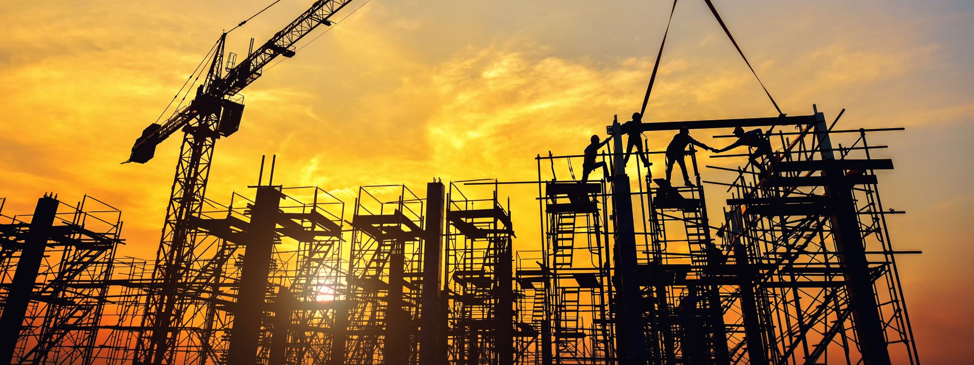
Over the years there has been a lot of advancement in the field of construction material and designing

Slide 2
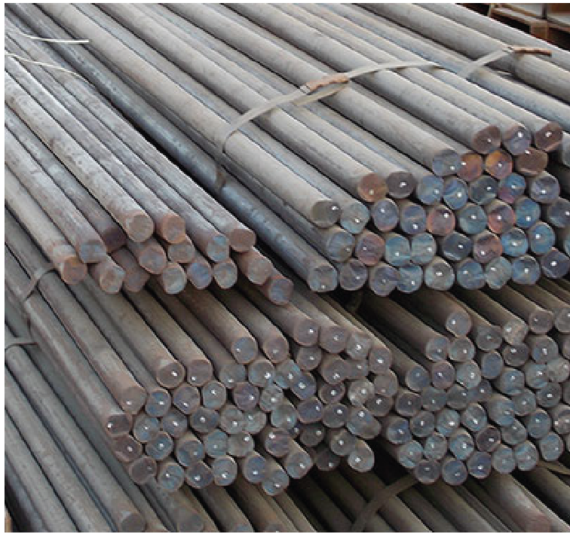
Advancement in the Field of rebars Manufacturing
Upto 1960’s Round Bars of Fe250 grade

Slide 3
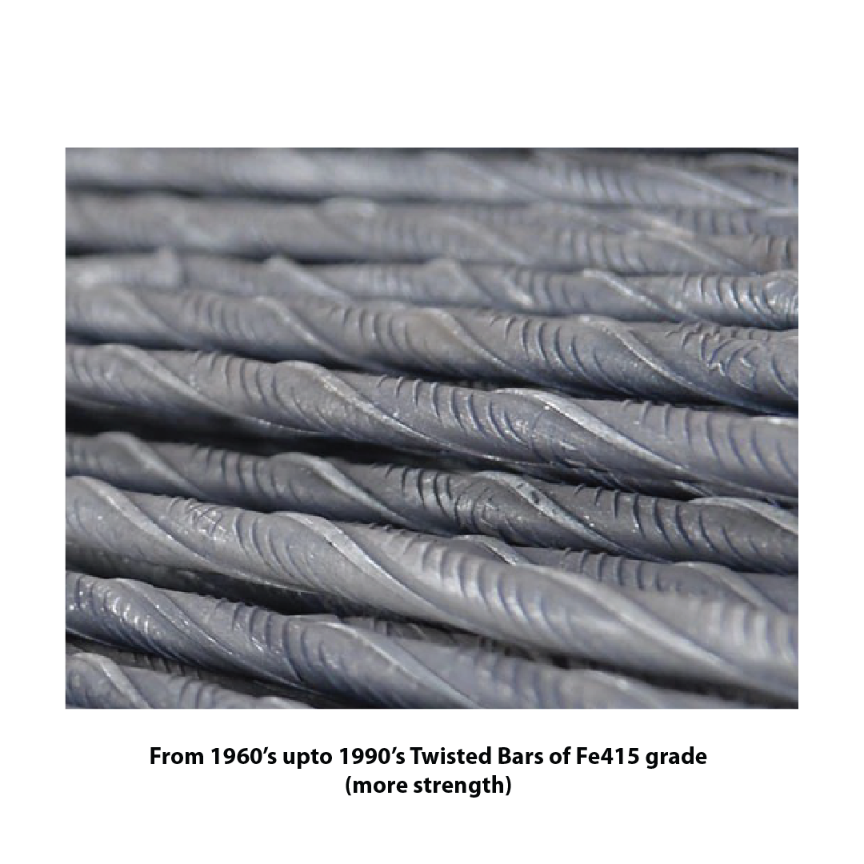
Advancement in the Field of rebars Manufacturing
From 1960’s upto 1990’s Twisted bars of Fe415 grade
( More Strength)

Slide 4
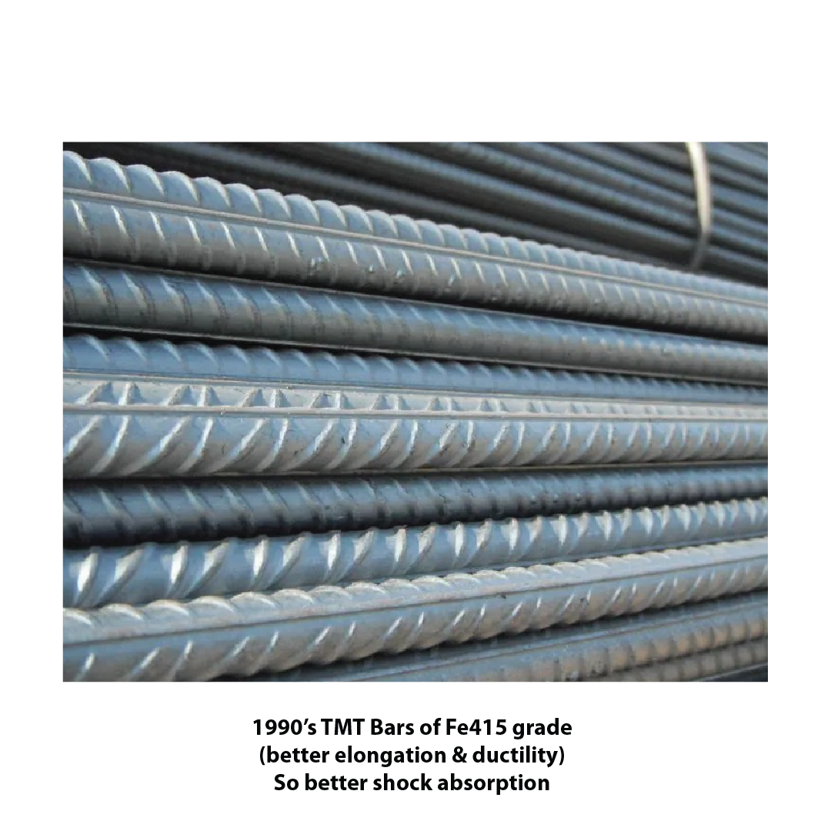
Advancement in the Field of rebars Manufacturing
1990’s TMT Bars of Fe 415 grade
(better elongation & ductility)
So better shock absorption

Slide 5
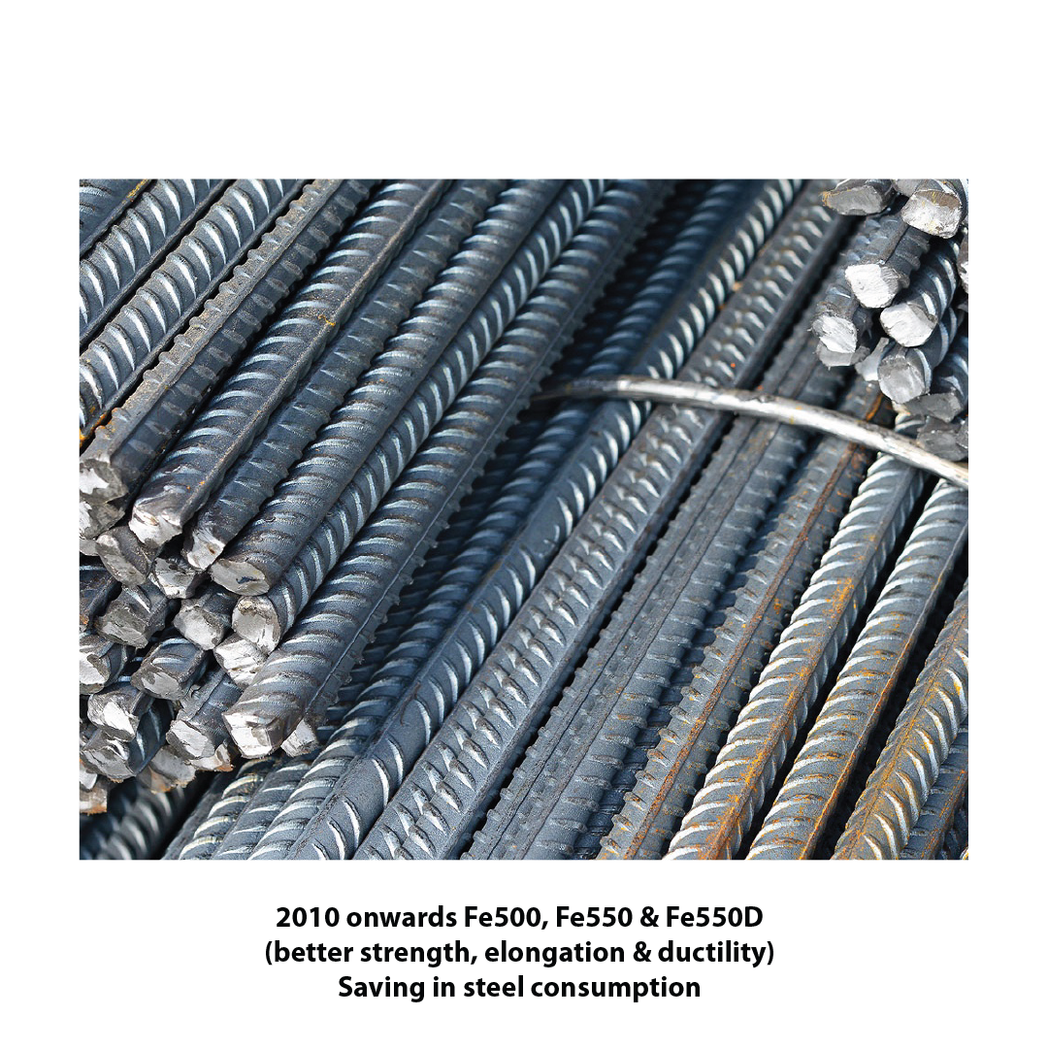
Advancement in the Field of rebars Manufacturing
2010 onwards Fe500, Fe550 & Fe550D
(better strength, elongation & ductility)
Saving in Steel Consumption

Slide 6
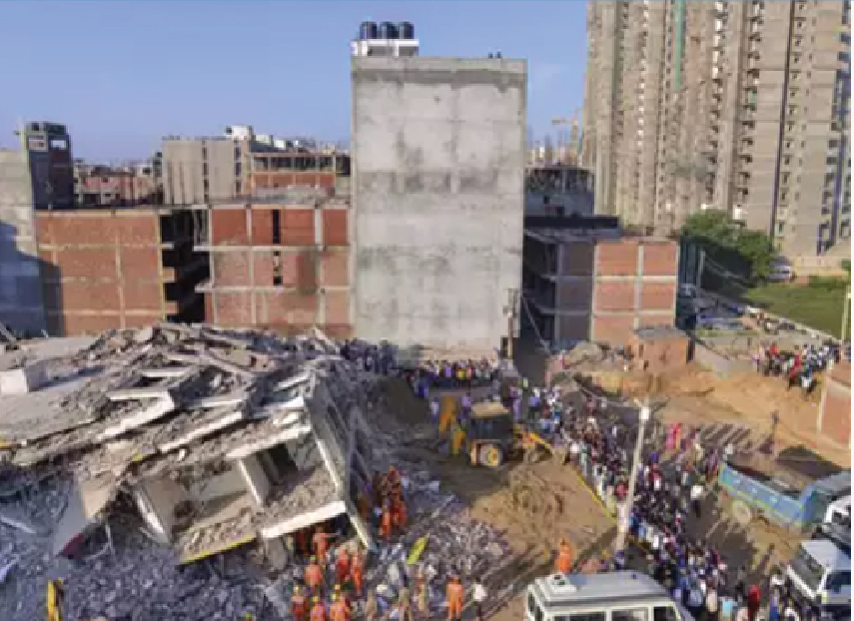
However, cases of building collapse continue to happen-

Slide 7
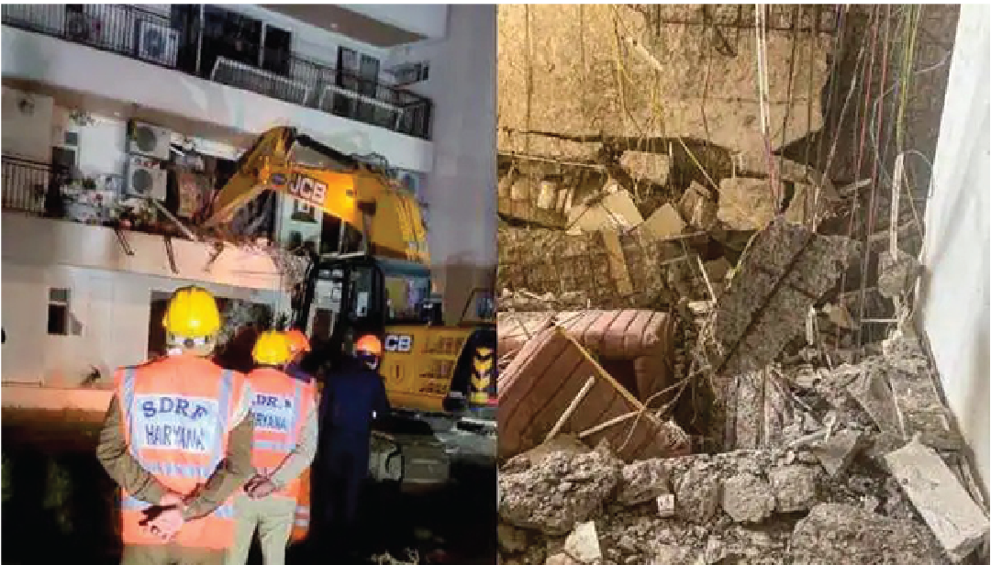
However, cases of building collapse continue to happen-

Slide 8

This is of great concern for-
Architects

Slide 9

This is of great concern for-
Civil Engineers

Slide 10
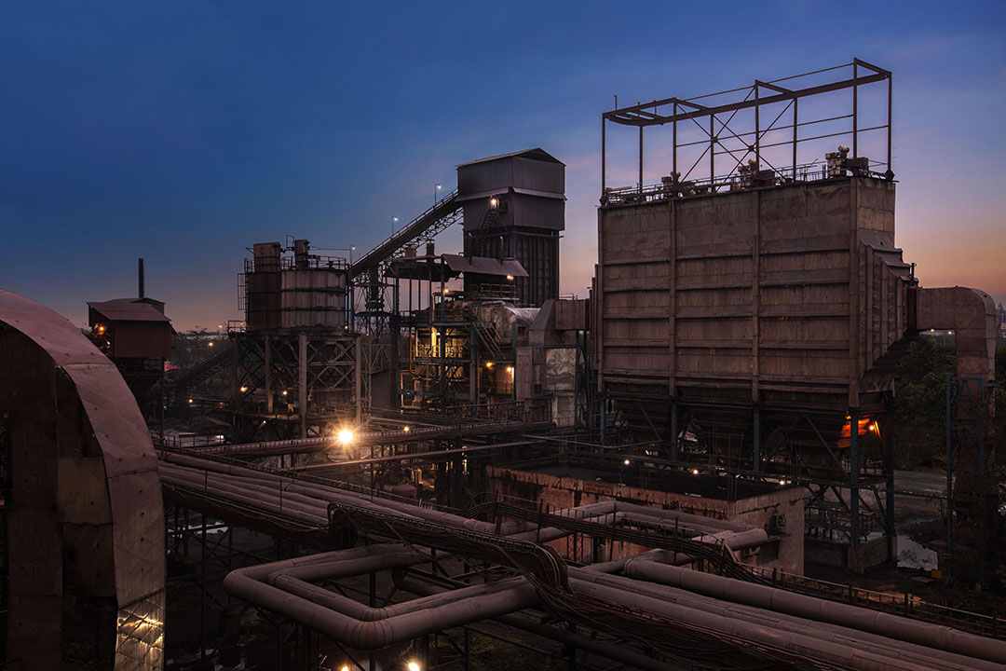
This is of great concern for-
Rebar Manufacturers

Slide 11
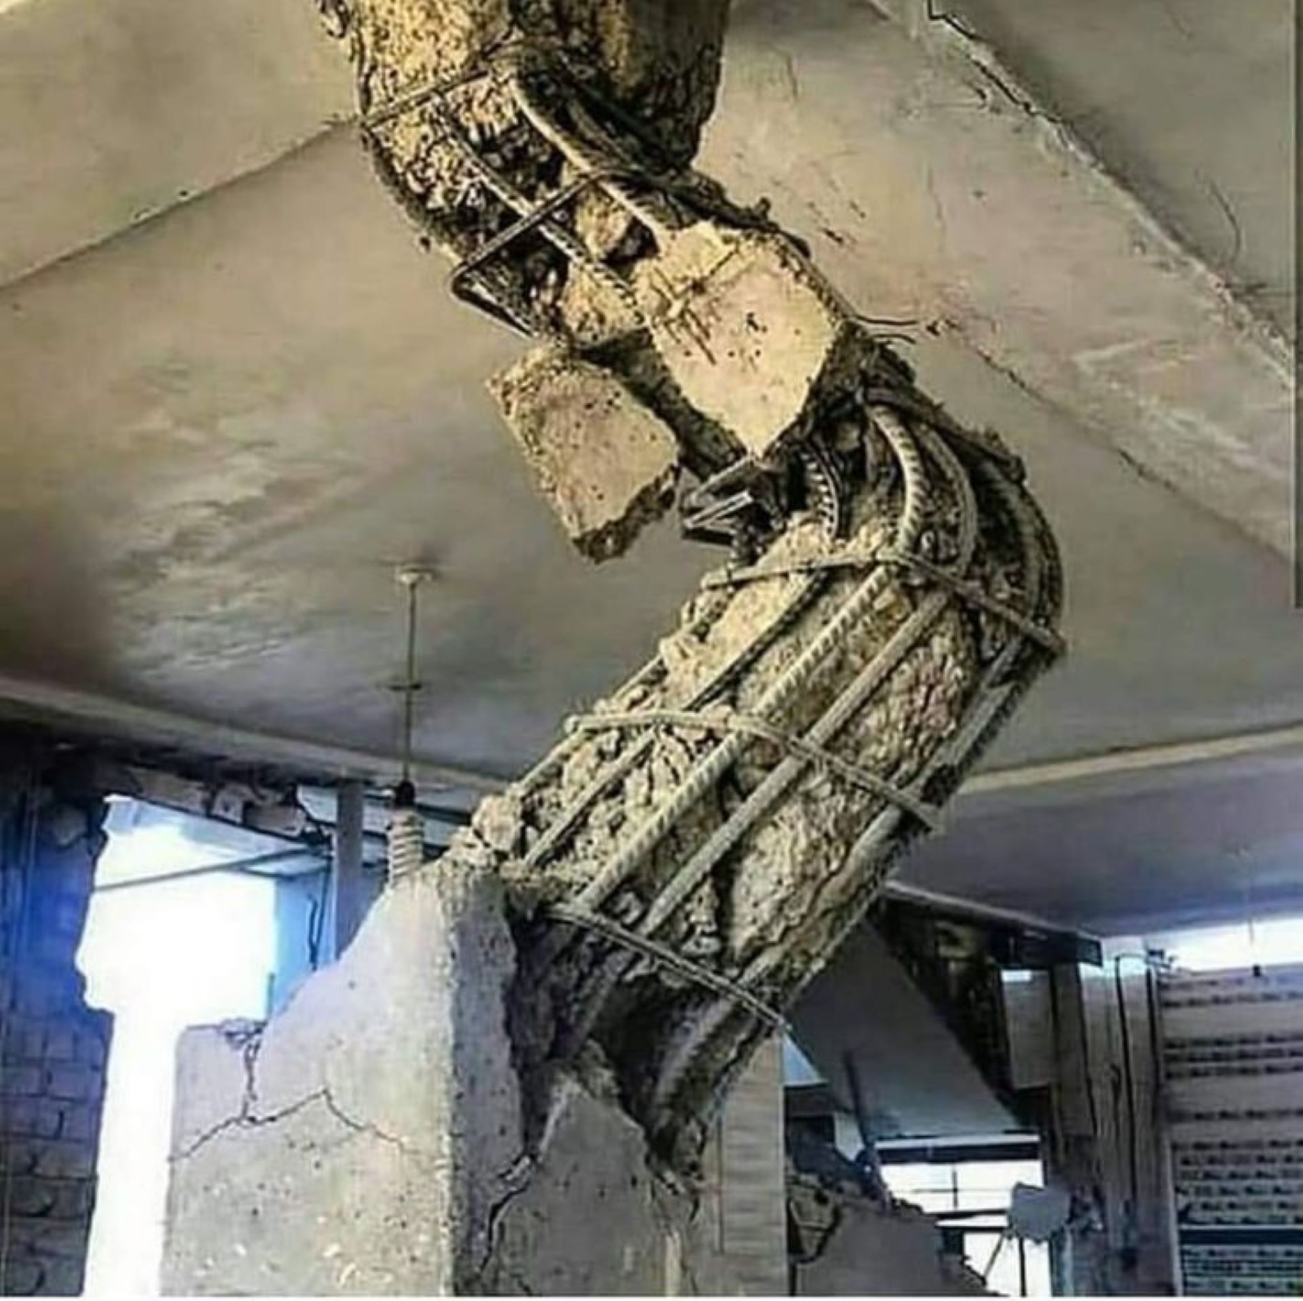
What is the main reason for building collapse?
Structural Failure

Slide 12
Good quality steel is available in the market - still there are cases of STRUCTURAL FAILURE.
CAN WE DO SOMETHING
?

Slide 13
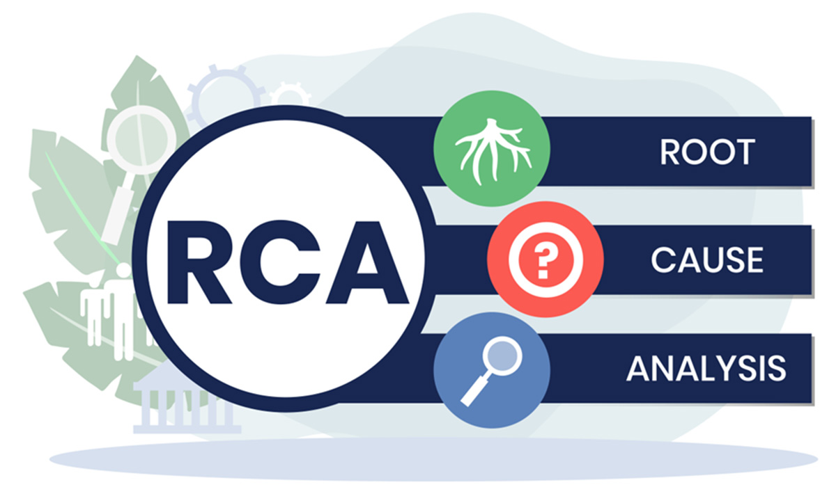
We have been manufacturing steel rebars for 8 decades. Therefore, we have put in our best efforts to find the root cause of this problem.

Slide 14
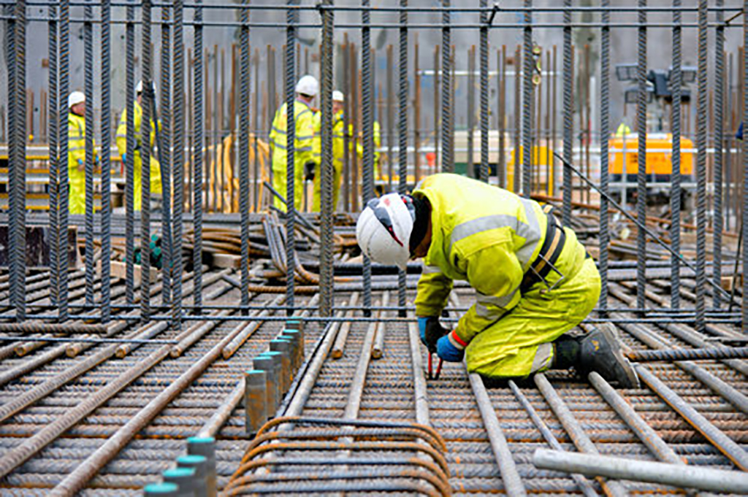
What did our study show?
Steel cage is the real strength in any type of construction.
To make a strong house, the steel cage of the house must be made strong.
Making a strong steel cage requires a proper procedure to be followed.

Slide 15
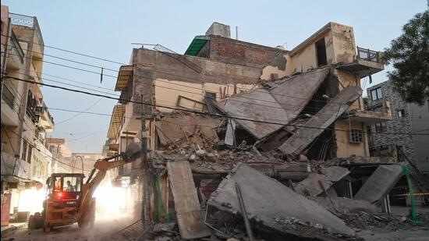
In cases of building collapse
Complete procedure to make a strong steel cage
NOT
followed.

Slide 16
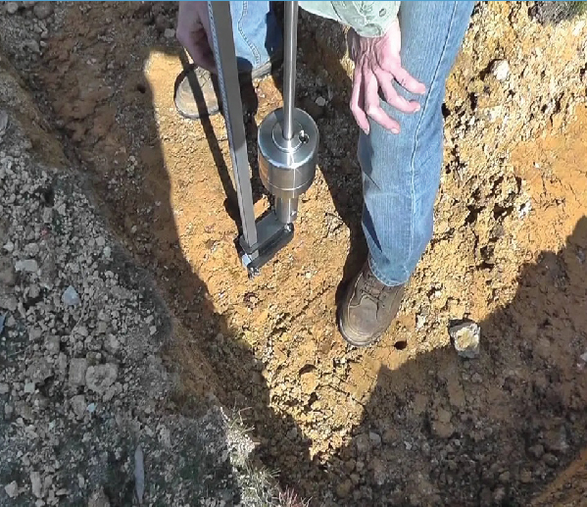
No soil testing done at site.

Slide 17
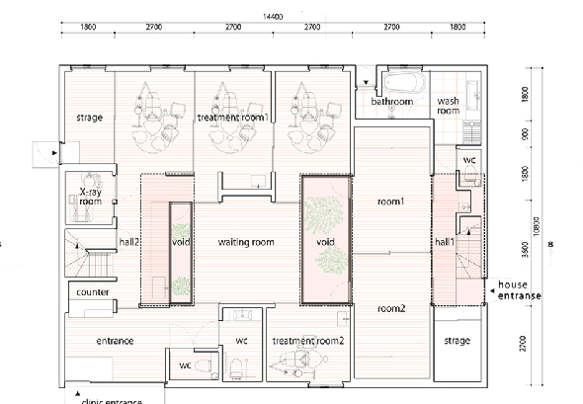
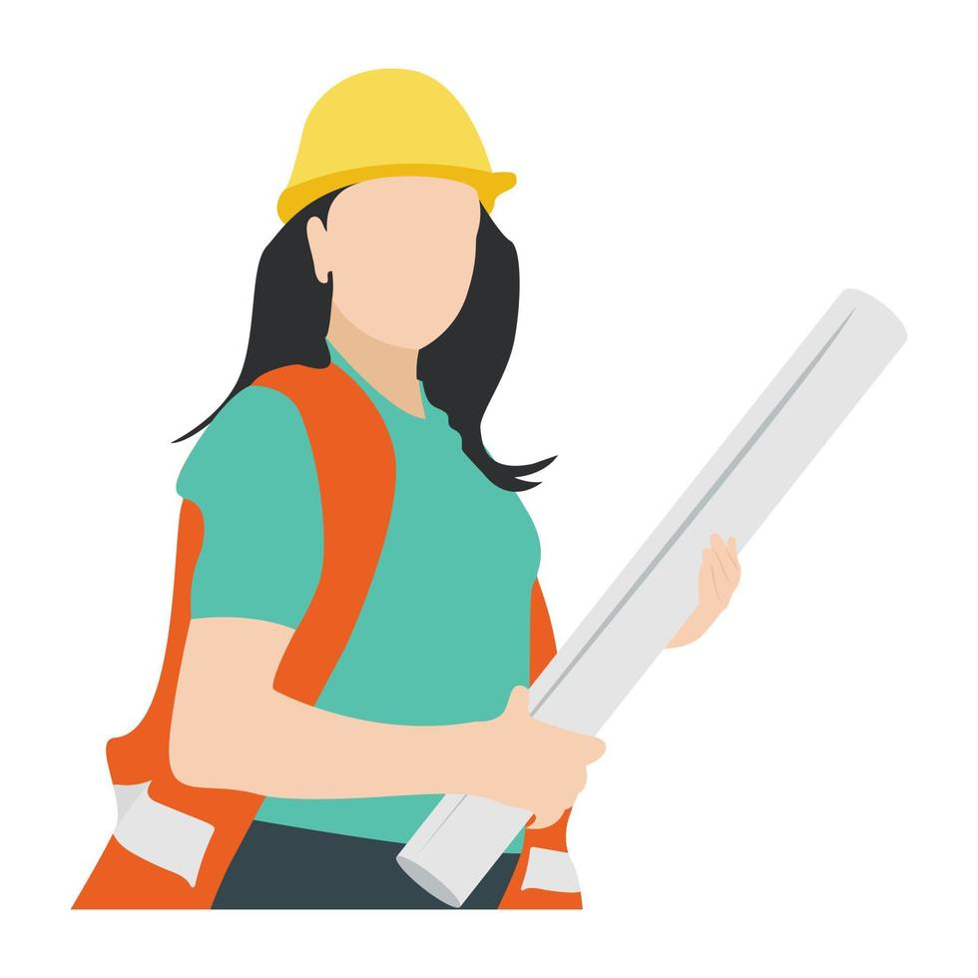
No design found at site
There was no structural design available at site.

Slide 18
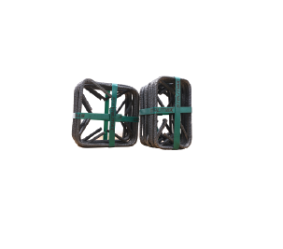
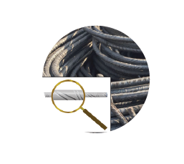
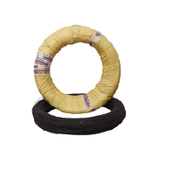
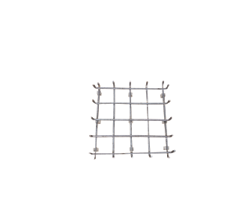
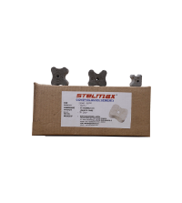
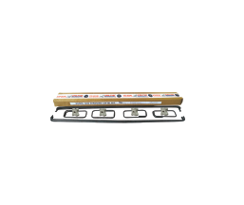
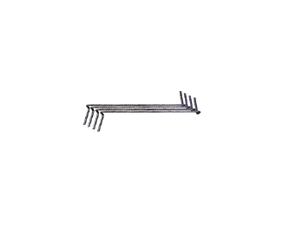
All Products Not Used
TMT BARS
RINGS
BINDING WIRE
FOOTING JAAL
COVER BLOCKS
LINTEL BEAM KIT
All products required for making a strong steel cage were not used.
STEEL SPACERS

Slide 19
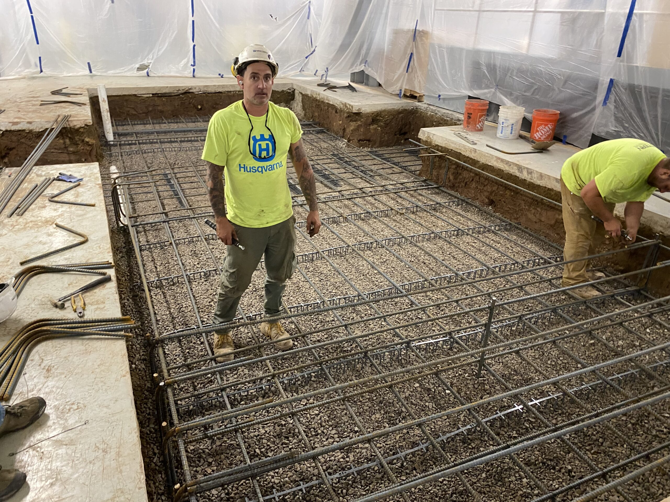
Poor Workmanship
Contractor engaged to make the steel cage did not follow the design properly.

Slide 20
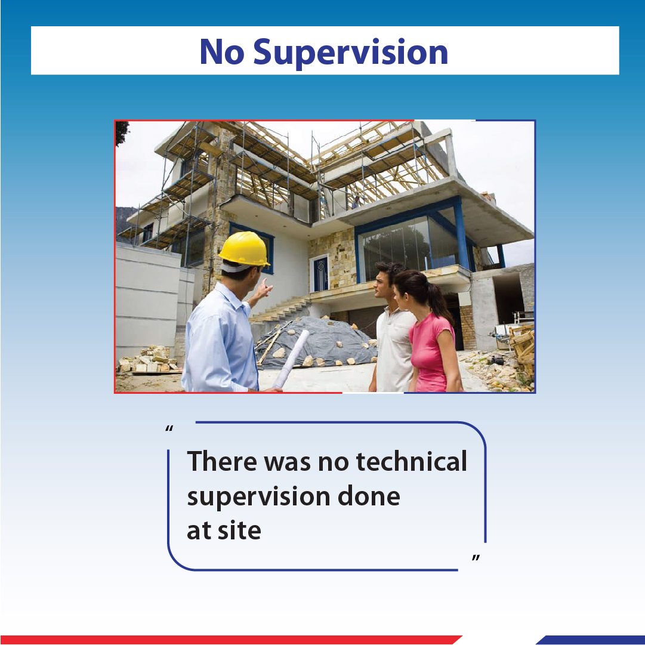
No Supervision
There was no technical supervision done at site.

Slide 21
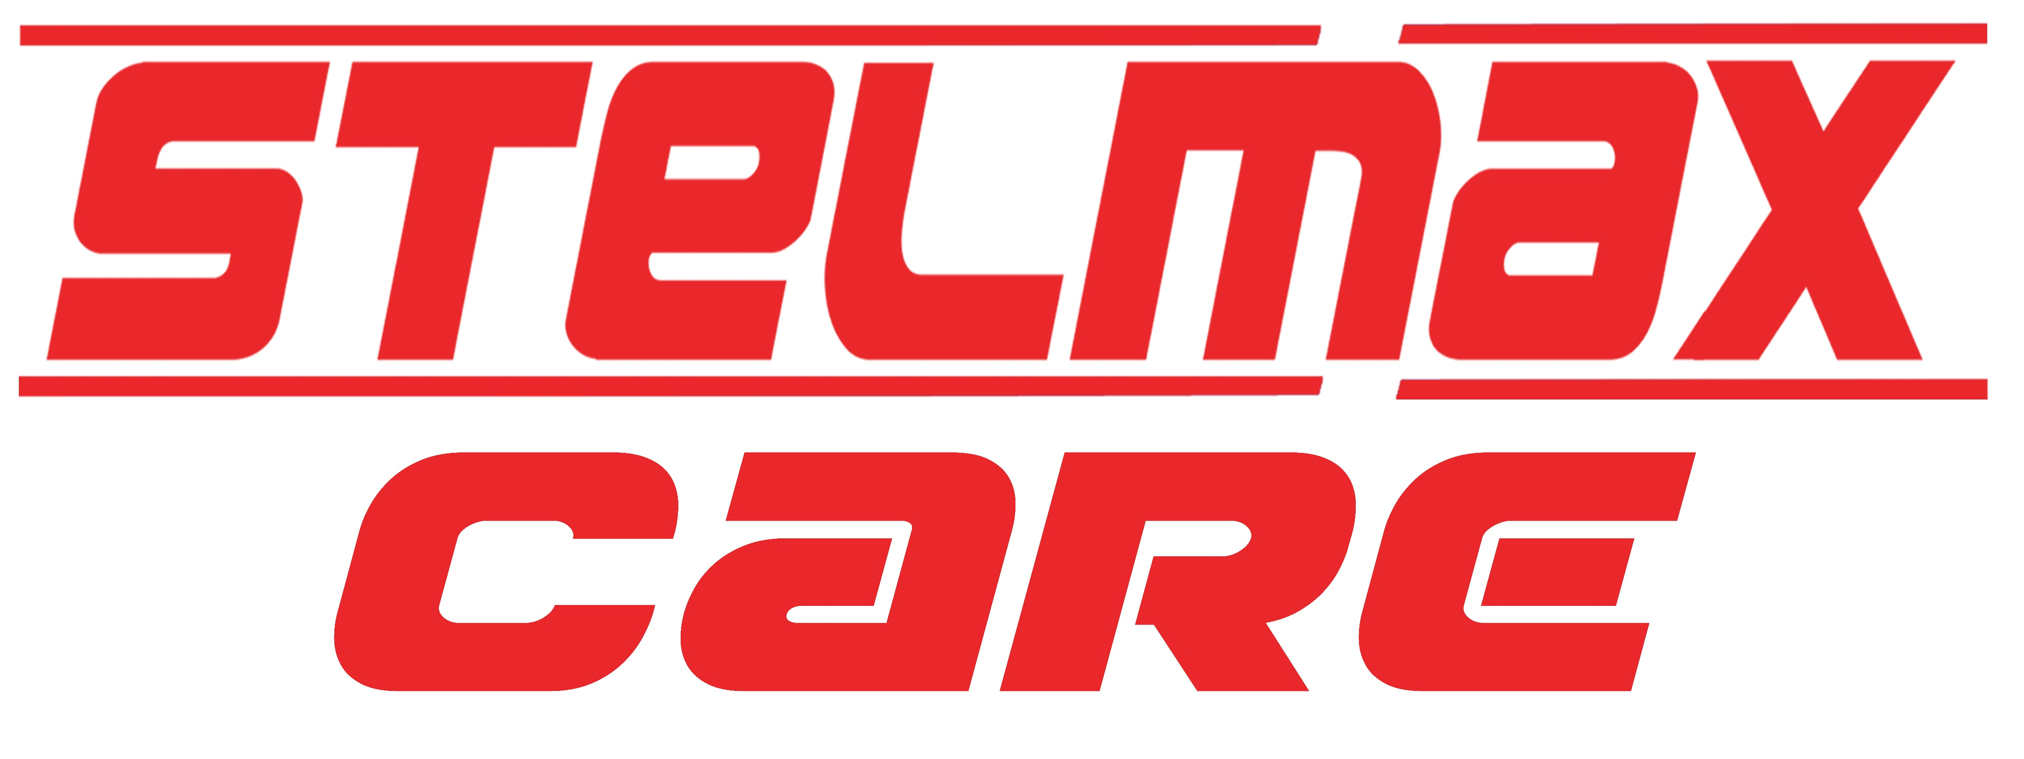
As a manufacturer we have decided to take up this issue
HERE IS A SOLUTION from
RATHI INDUSTRIES LIMITED

Slide 22

C –
CONSULT FOR DESIGN SUPPORT
A –
APPROACH FOR
WORKMANSHIP
R –
REACH FOR
GOOD PRODUCT
E –
ENGAGE FOR
TECHNICAL SUPPORT

Slide 23
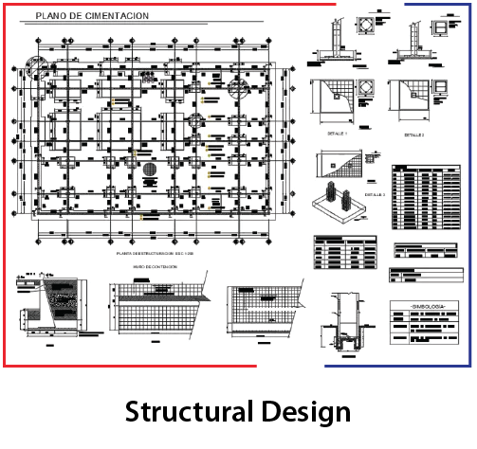
C- CONSULT FOR DESIGN SUPPORT
STELMAX helps in making structural design along with assessment of items required for making a strong STEEL CAGE.

Slide 24
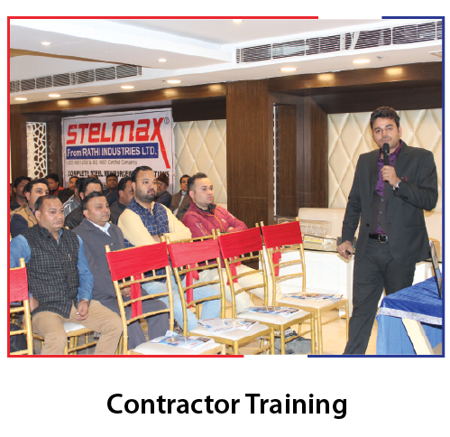
A- APPROACH FOR WORKMANSHIP
STELMAX gives on site training to contractors. If required, it also provides a list of company trained contractors in every area.

Slide 25
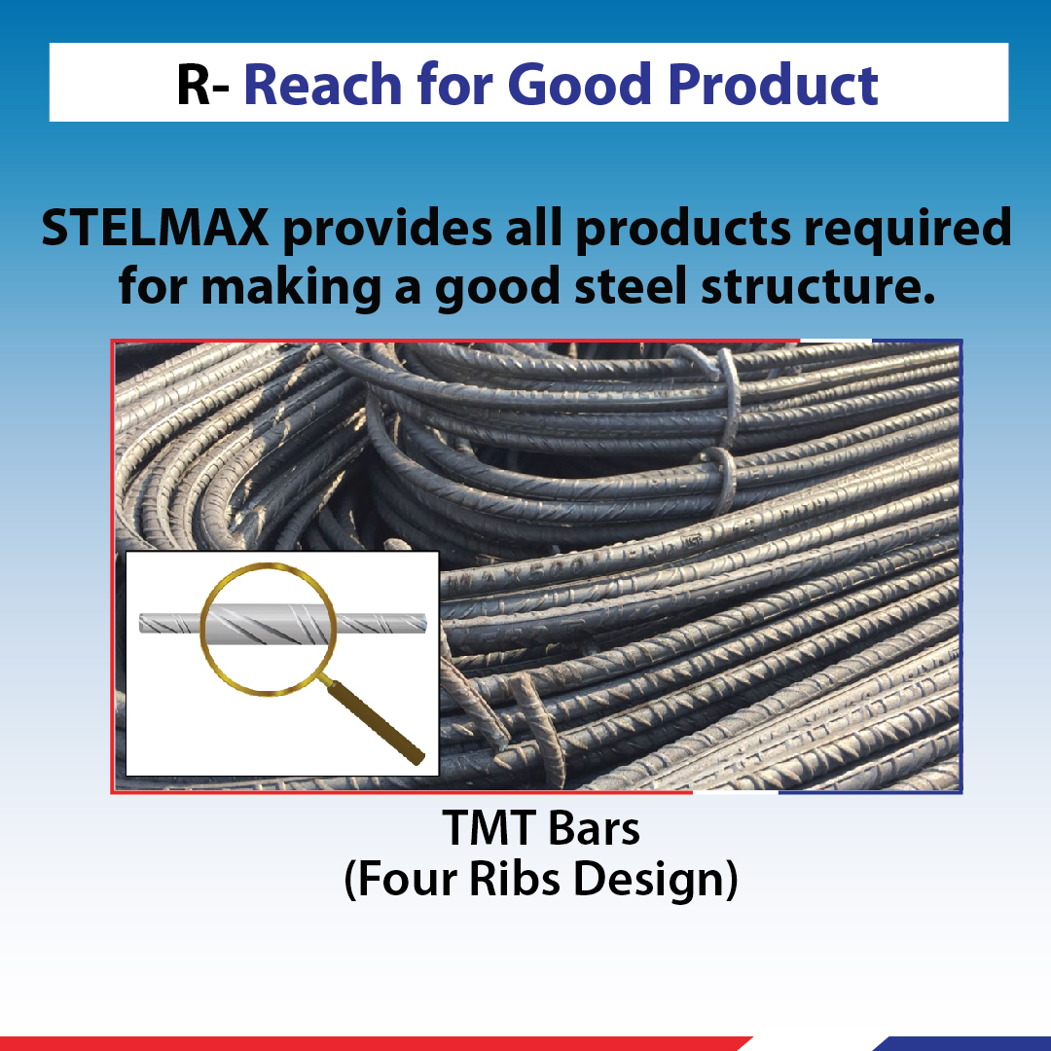
R- REACH FOR GOOD QUALITY PRODUCTS
STELMAX provides all good quality products required for making a strong STEEL CAGE.

Slide 26
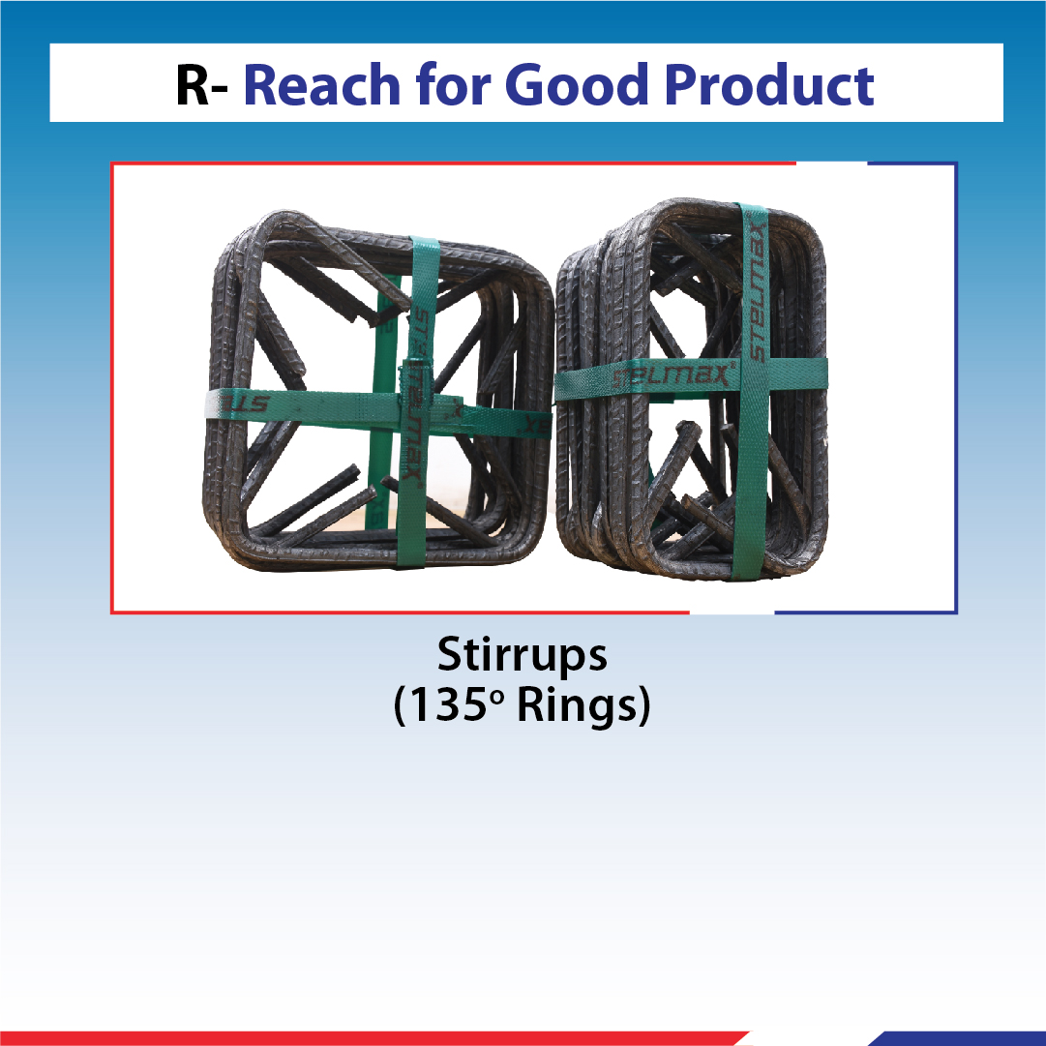
R- REACH FOR GOOD QUALITY PRODUCTS
STELMAX provides all good quality products required for making a strong STEEL CAGE.

Slide 27
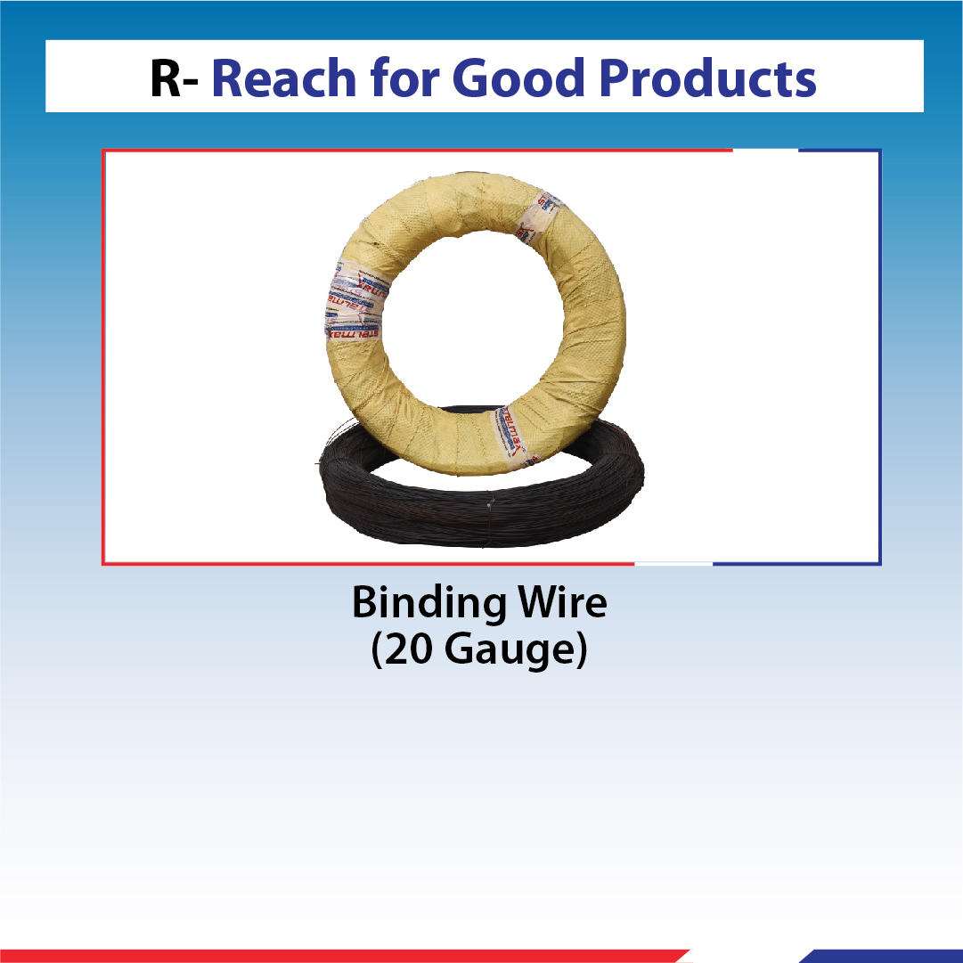
R- REACH FOR GOOD QUALITY PRODUCTS
STELMAX provides all good quality products required for making a strong STEEL CAGE.

Slide 28
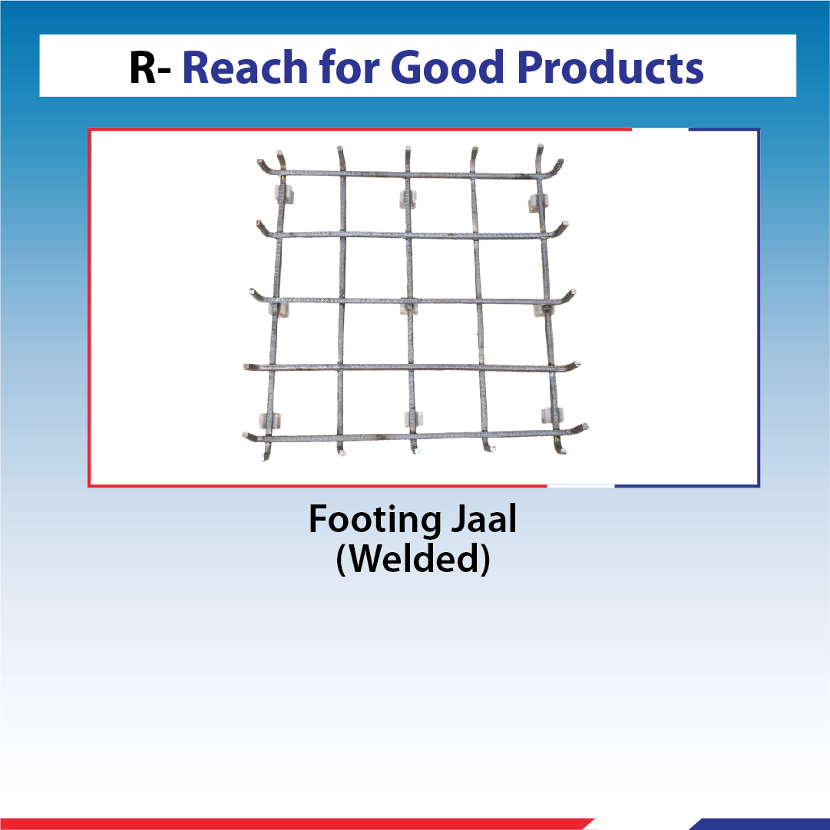
R- REACH FOR GOOD QUALITY PRODUCTS
STELMAX provides all good quality products required for making a strong STEEL CAGE.

Slide 29
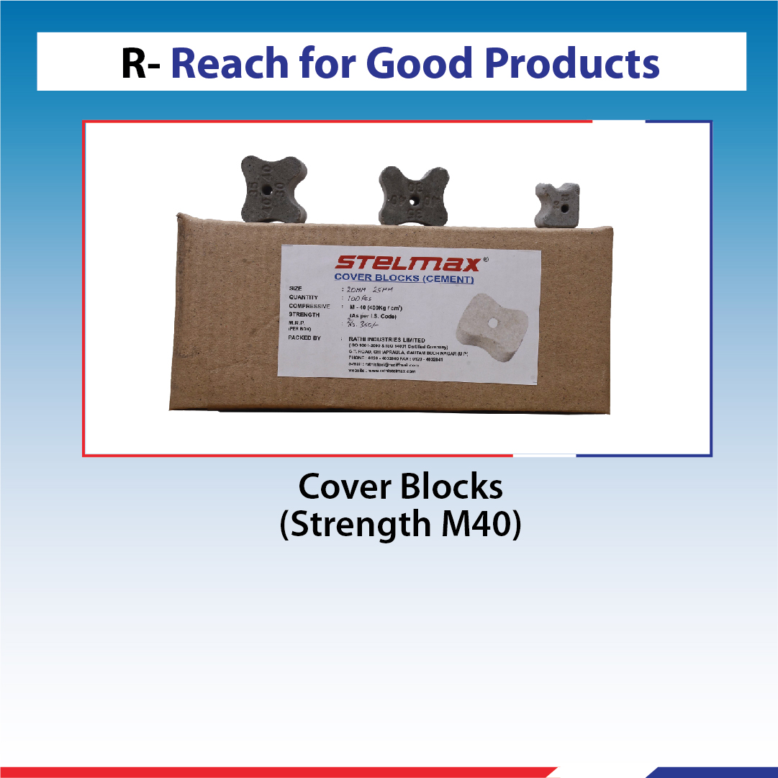
R- REACH FOR GOOD QUALITY PRODUCTS
STELMAX provides all good quality products required for making a strong STEEL CAGE.

Slide 30
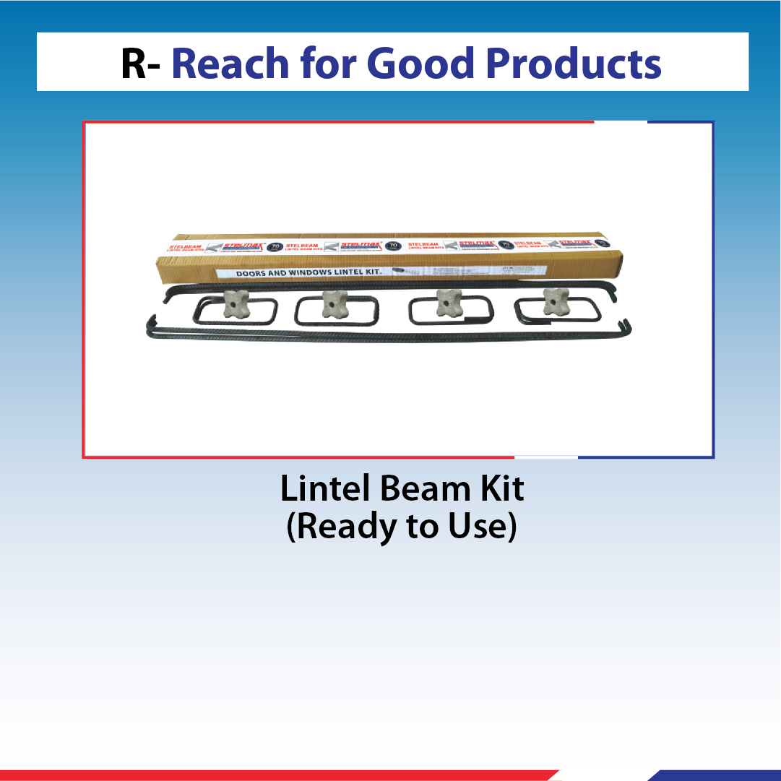
R- REACH FOR GOOD QUALITY PRODUCTS
STELMAX provides all good quality products required for making a strong STEEL CAGE.

Slide 31
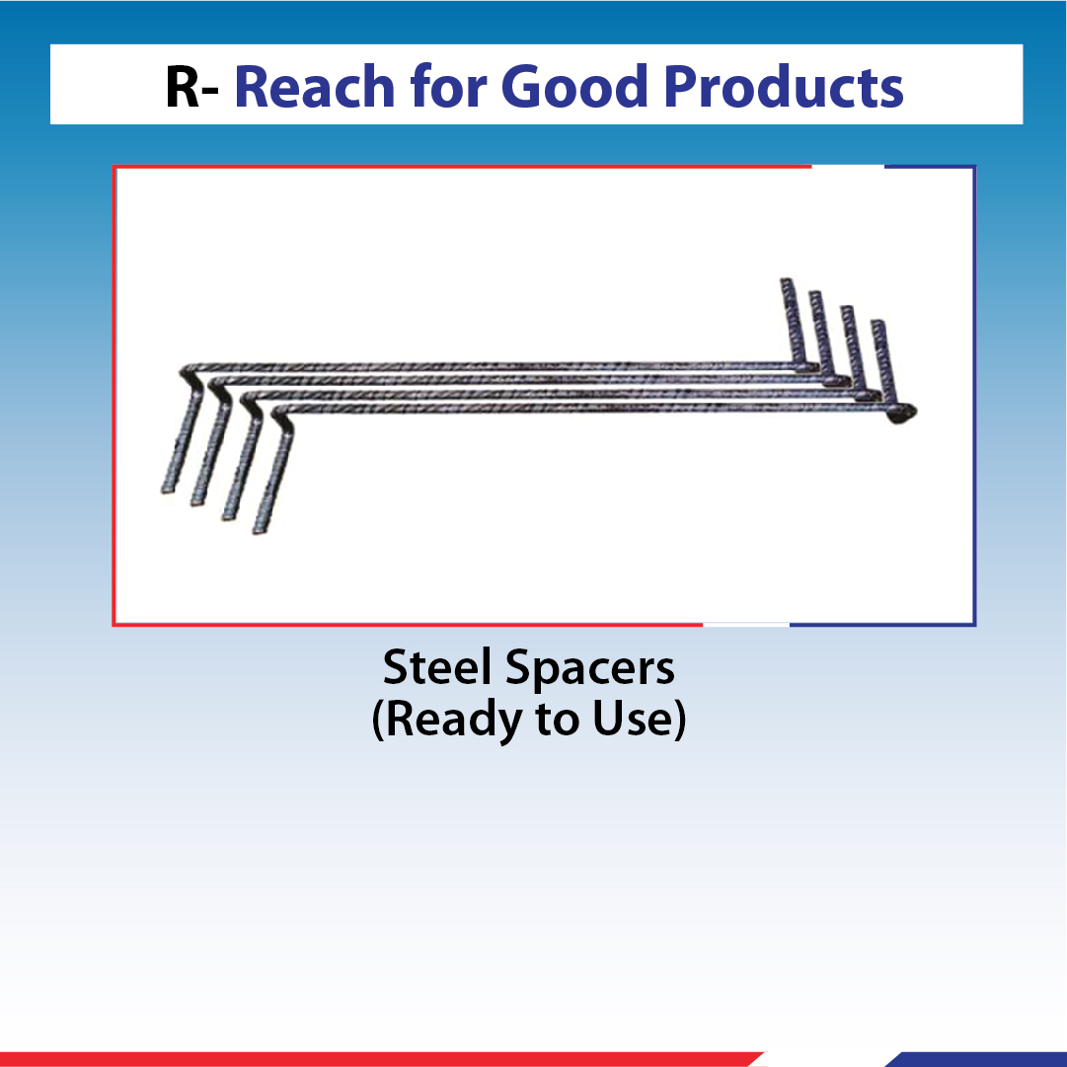
R- REACH FOR GOOD QUALITY PRODUCTS
STELMAX provides all good quality products required for making a strong STEEL CAGE.

Slide 32
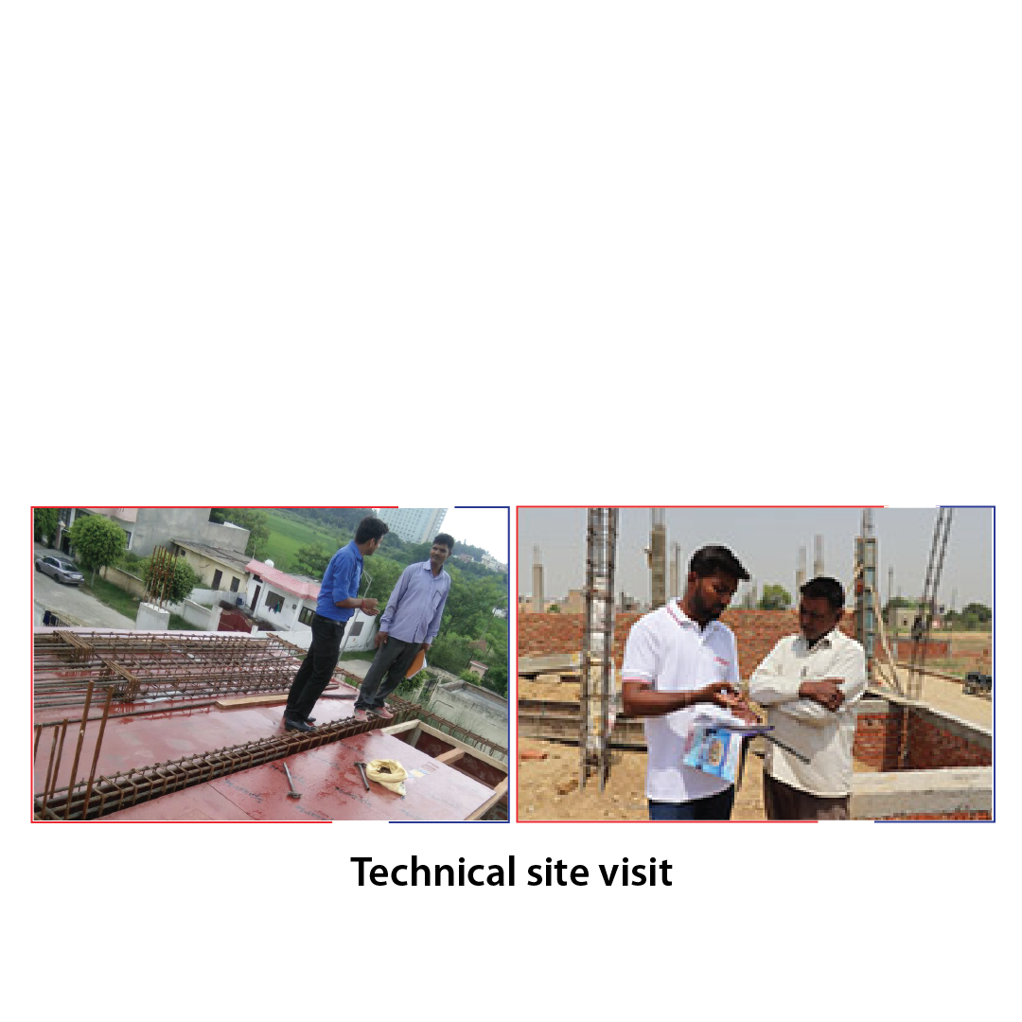
E- ENGAGE FOR TECHNICAL SUPPORT
STELMAX provides technical site visits at construction sites.
TECHNICAL SITE VISIT

Slide 33
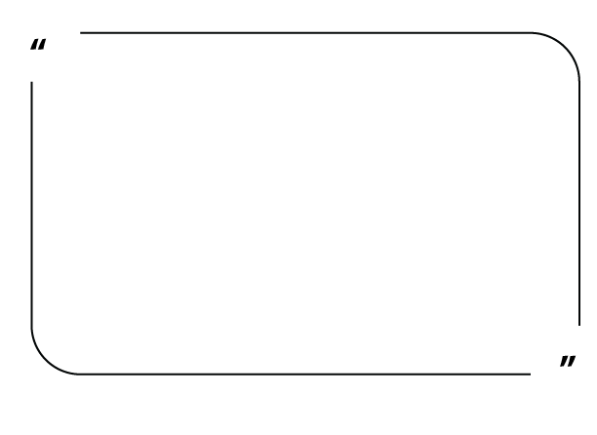
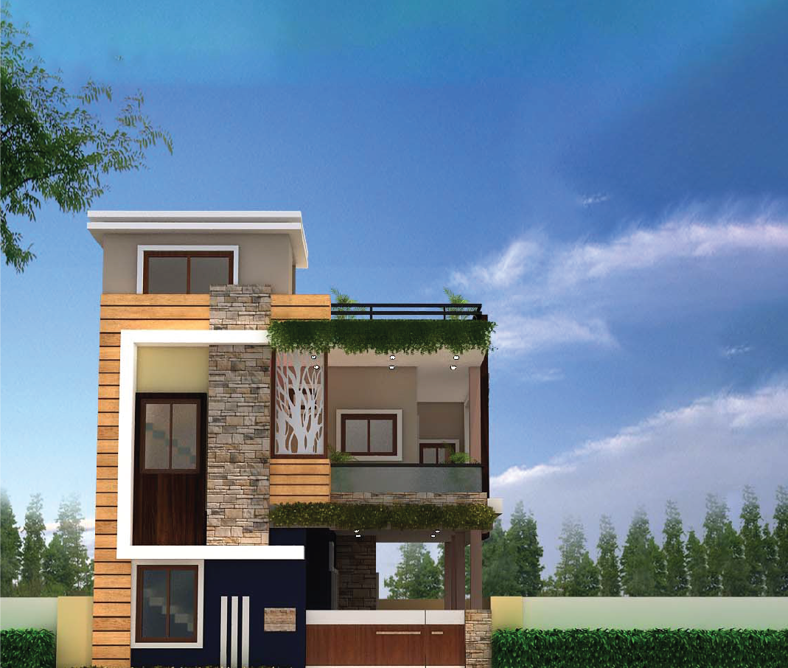
OUR MOTTO

Slide 34


