Slide 1


WHY DO WE BUILD A HOUSE ?
IS IT JUST A STATUS SYMBOL OR A BASIC NECESSITY ?

Slide 2


A HOUSE IS NOTJUST A STATUS SYMBOL. IT IS A BASIC NEED BECAUSE..
IT IS YOUR
PROTECTOR

Slide 3


IT PROTECTS US FROM :
Rain

Slide 4


IT PROTECTS US FROM :
Heat

Slide 5


IT PROTECTS US FROM :
Strong Wind
02

Slide 6
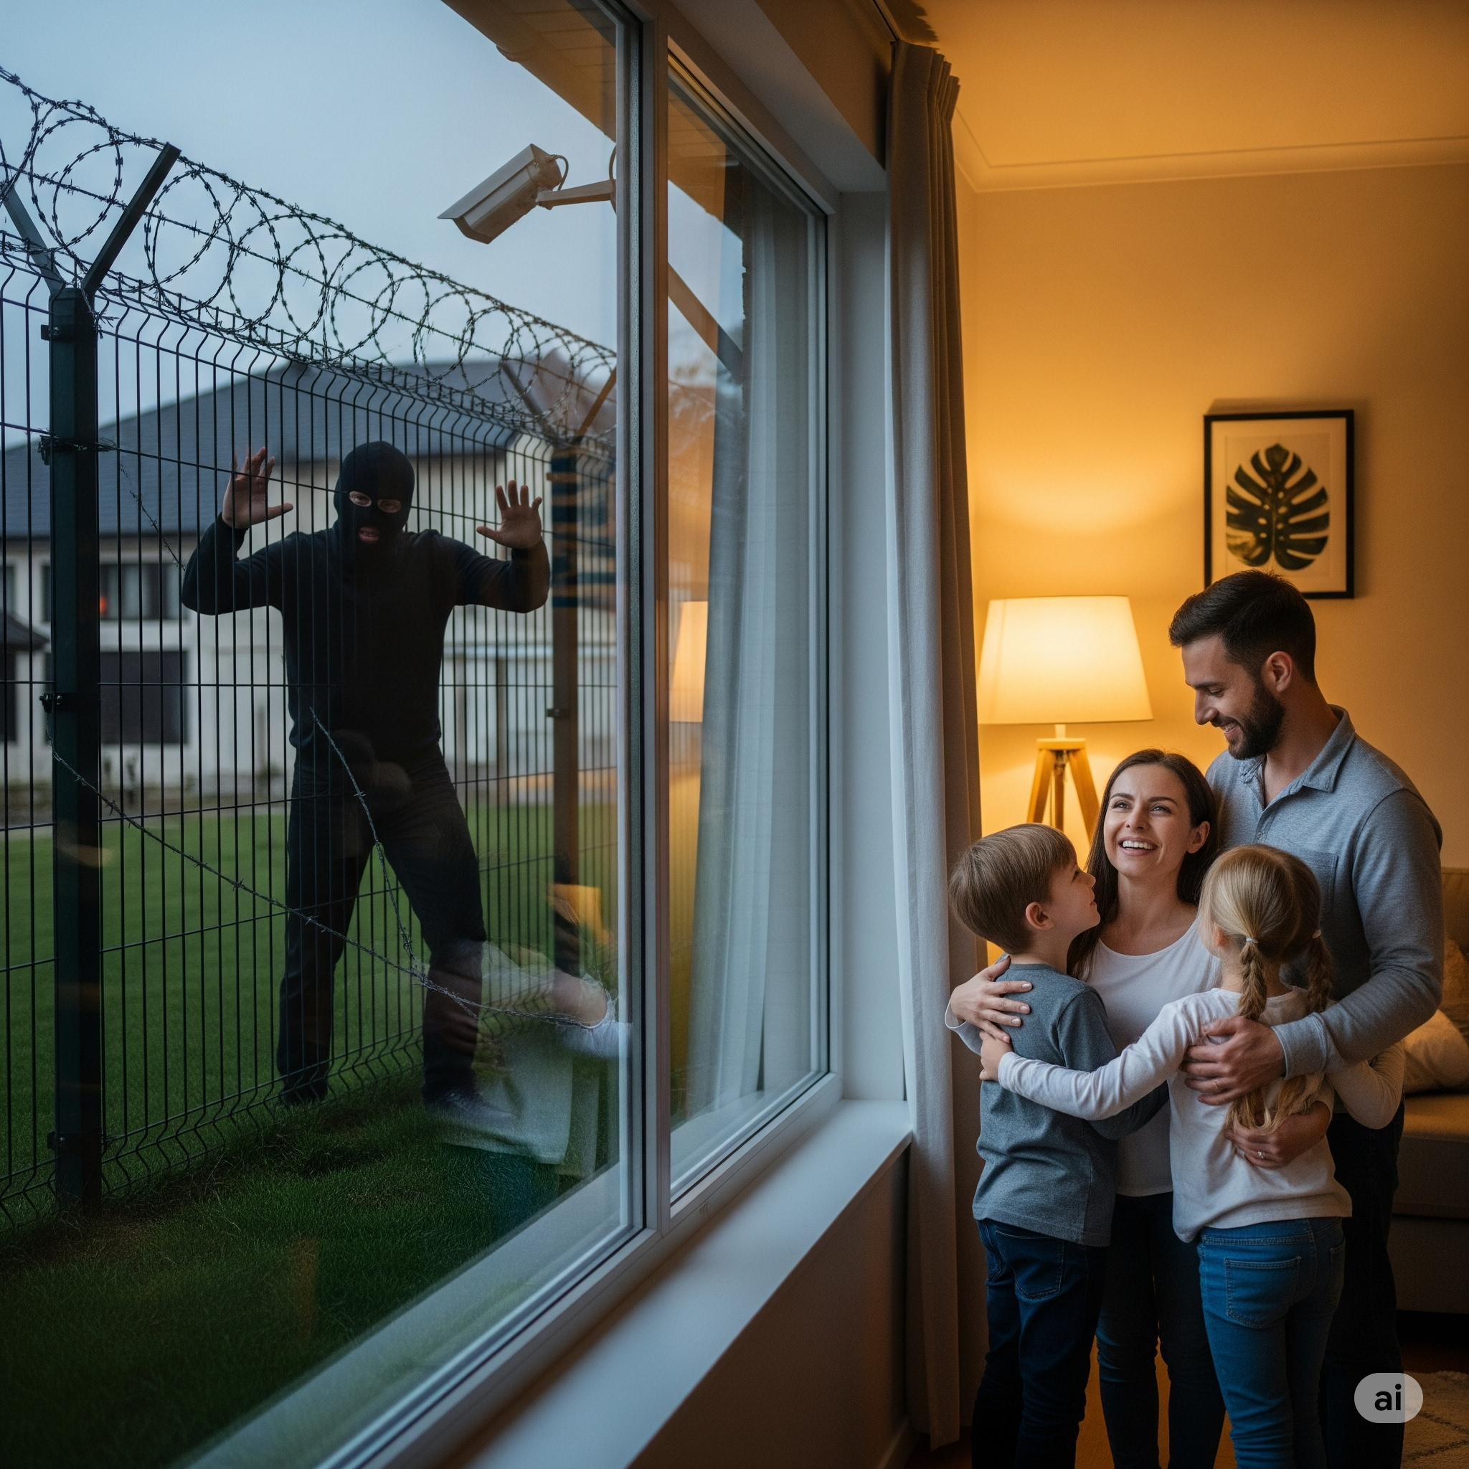
IT PROTECTS US FROM :
Theft & Crime

Slide 7

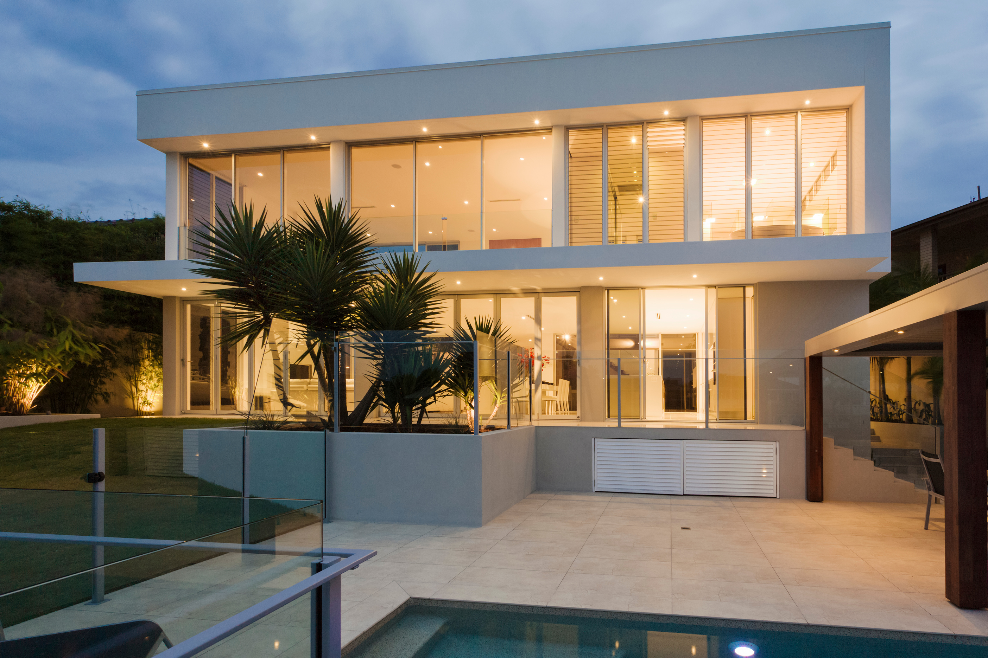

IF A HOUSE IS BUILT STRONG
ONLY THEN
IT CAN GIVE US PROTECTION.

Slide 8





HOW TO MAKE A STRONG HOUSE?
Let me ask a Civil Engineer.
What makes a House Strong?

Slide 9
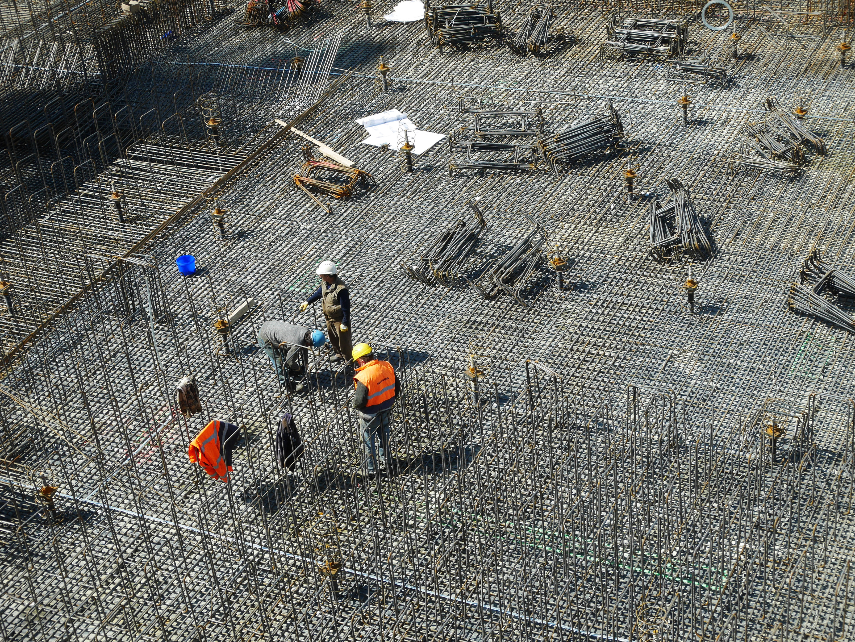
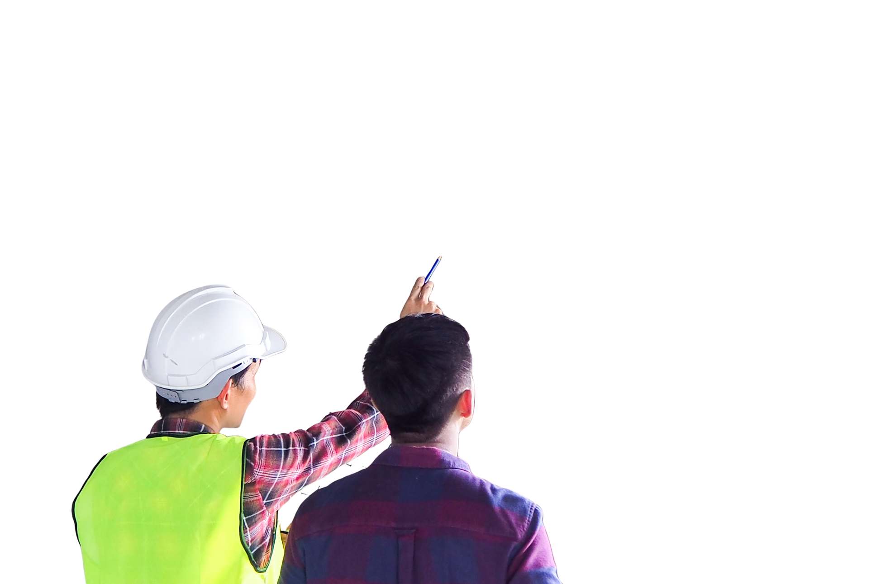
The real strength of a house lies in its STEEL CAGE.

Slide 10

WHAT MAKES A STEEL CAGE STRONG?
Is it Only
Good Quality Steel?
NO
There are certain other
parameters also.

Slide 11
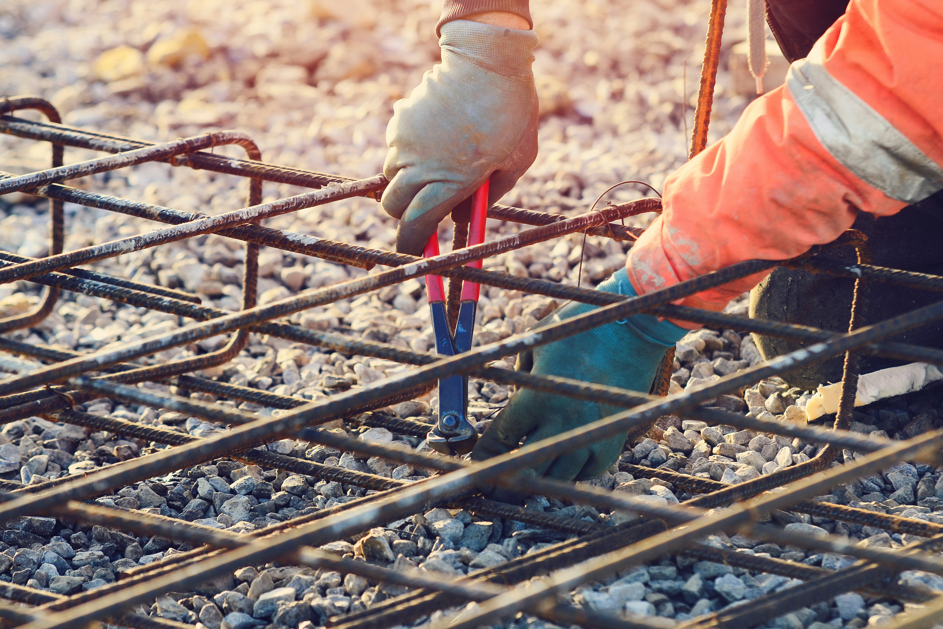

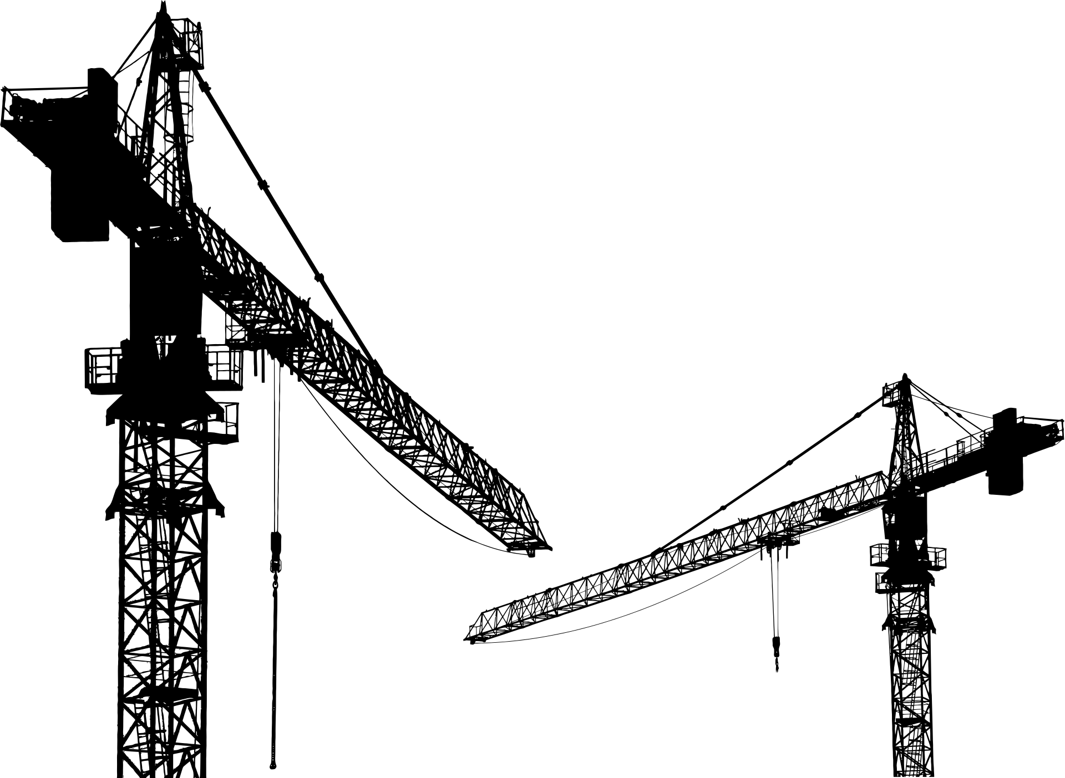
THE PARAMETERS TO BUILD A STRONG STEEL CAGE ARE :
Designing
Good Products to be used
Engage trained contractor
Technical Supervision

Slide 12

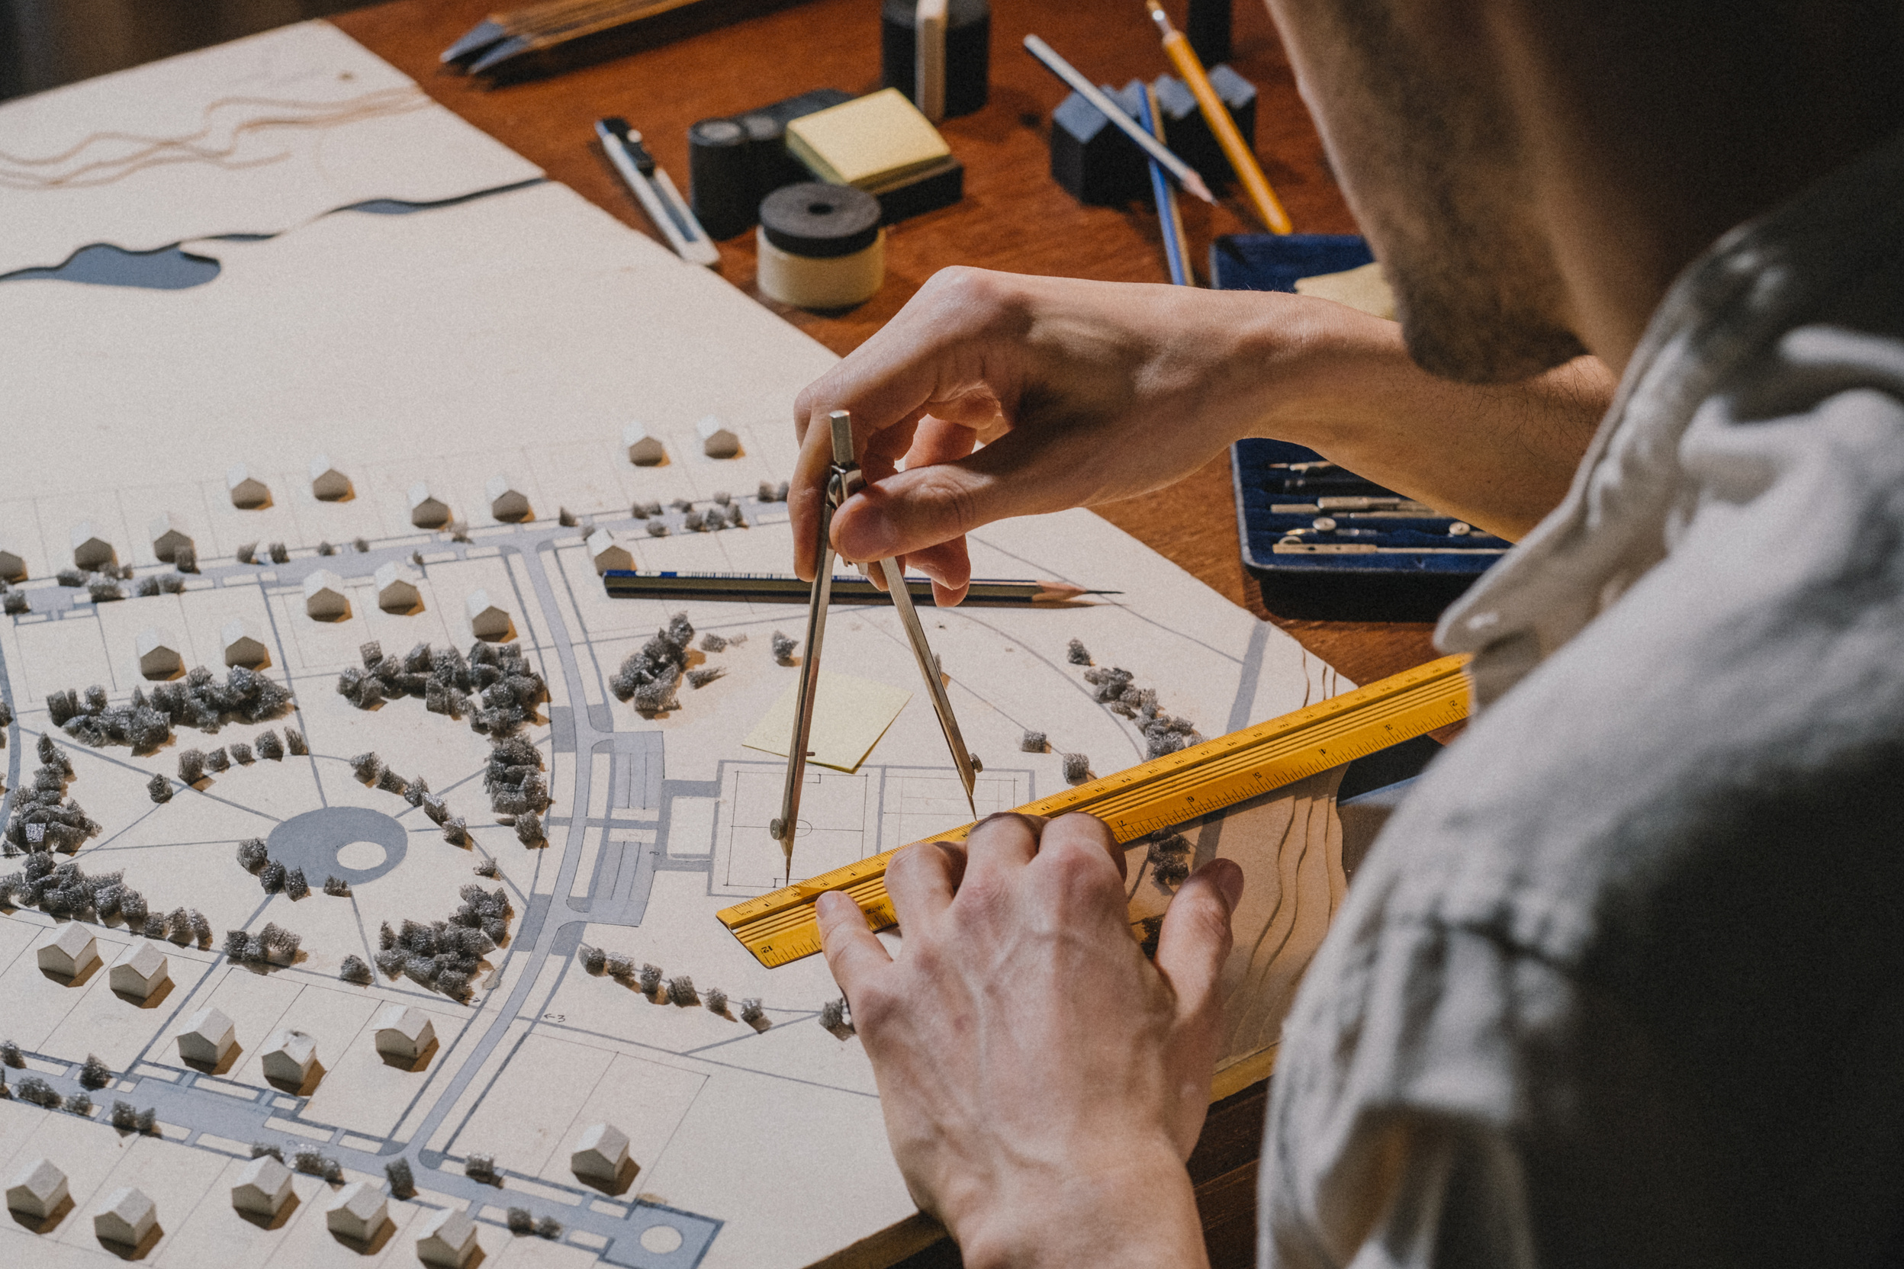
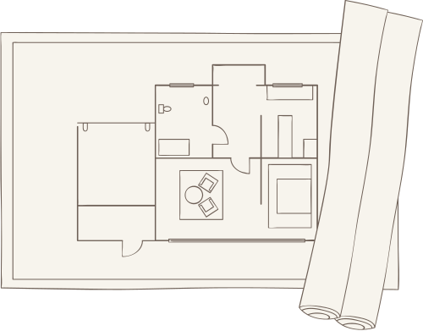
GOOD DESIGNING
“Get the Layout & Structural Design made by an Architect”
07

Slide 13
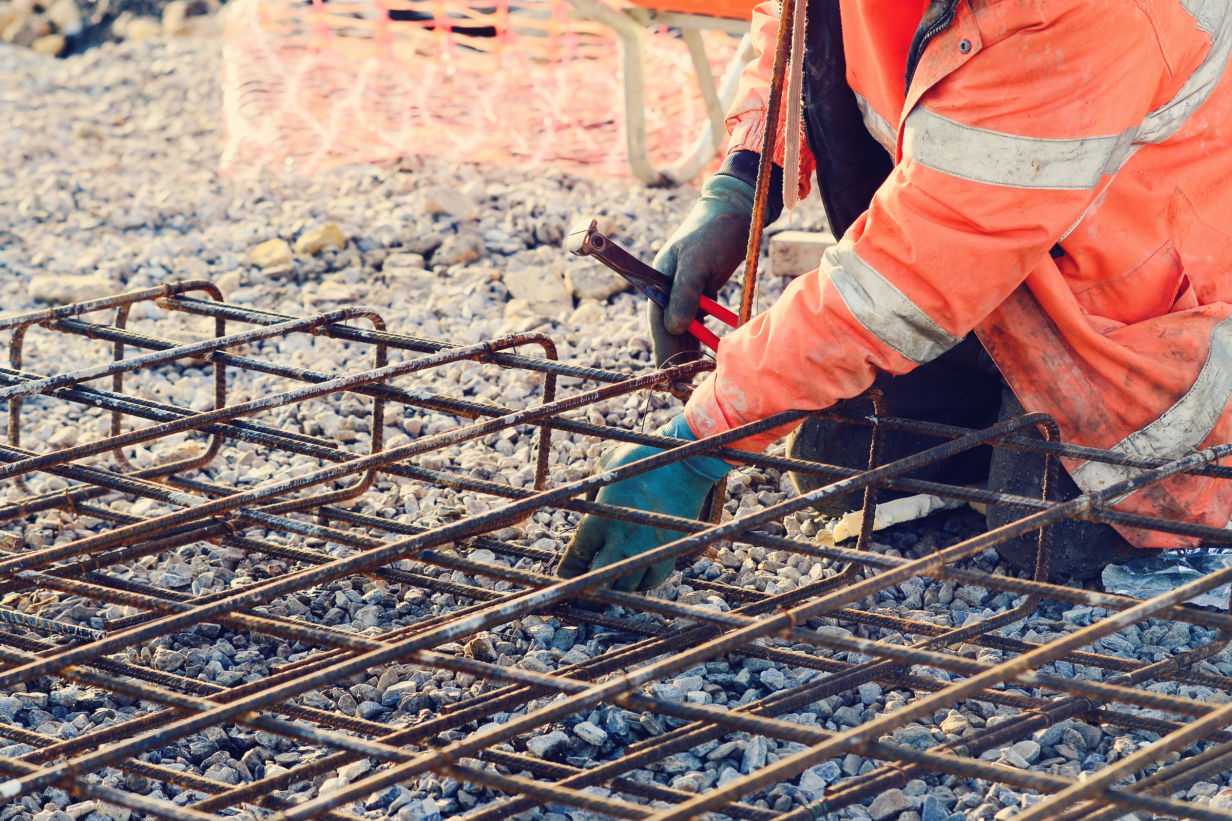
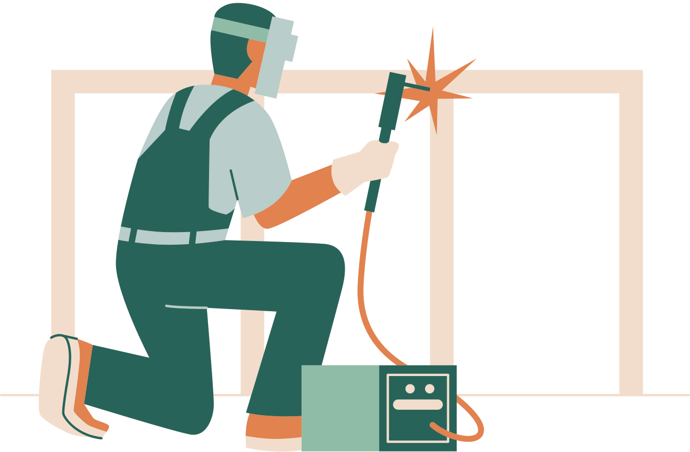

GOOD PRODUCTS
“Use Good Quality products for making the the Steel Cage”

Slide 14

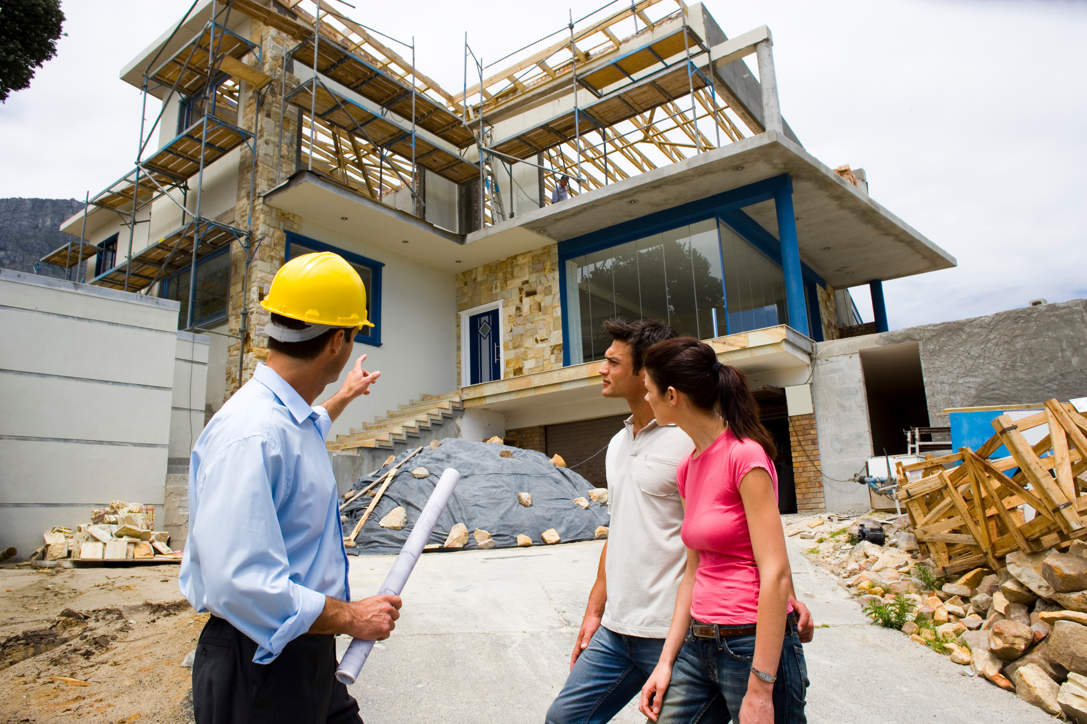
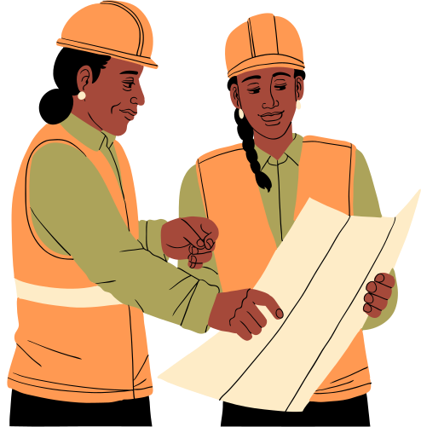

GOOD WORKMANSHIP
“Engage Trained Contractors for making the House”

Slide 15


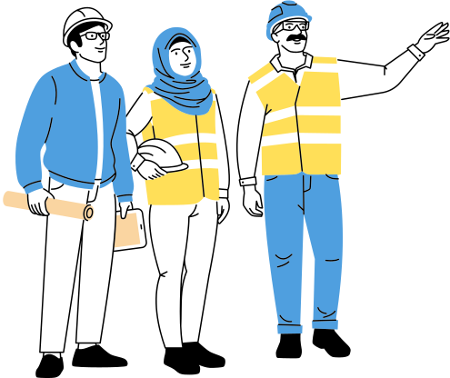
TECHNICAL SUPERVISION
“Get your site checked & Supervised by a Technical Person”

Slide 16


OH MY GOD!
How to arrange all this?
Designing
All Products
Trained Contractor
Mission
Technical Supervision

Slide 17

HERE IS THE SOLUTION
From
RATHI INDUSTRIES LIMITED

Slide 18

C
A
Consult for Design Support
Approach for Workmanship
R
E
Reach for Good Products
Engage for Technical Support

Slide 19
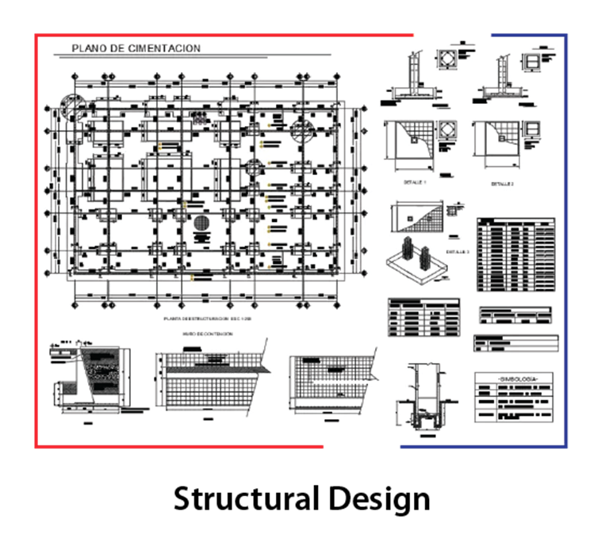
C - CONSULT FOR DESIGN SUPPORT
STELMAX helps in making structural design along with assessment of items required for making the steel cage.

Slide 20
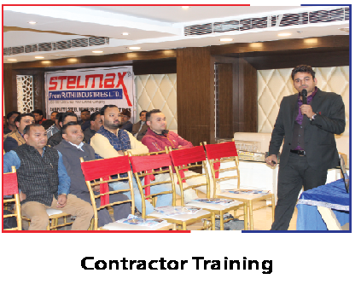
A - APPROACH FOR WORKMANSHIP
STELMAX provides on site training to contractors. If required, it also provides a list of company trained contractors in every area.

Slide 21
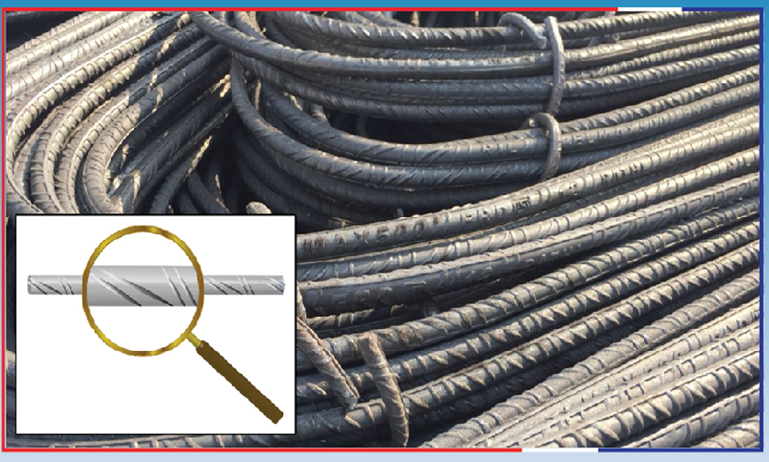
TMT Bars
(Four Rib Design)
“R - Reach for Good Product ”

Slide 22
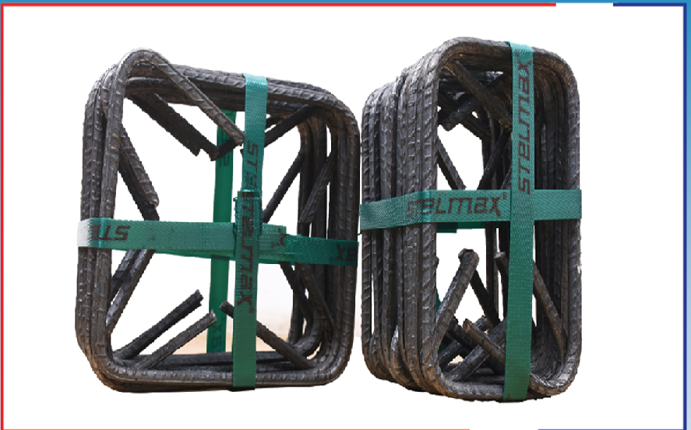
STIRRUPS
(135°RINGS)
“R - Reach for Good Product ”

Slide 23
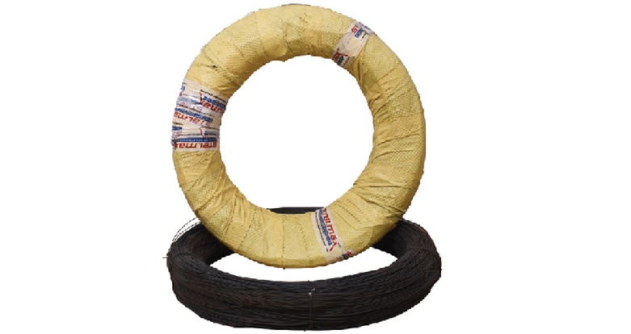
BINDING WIRE
(20 GAUGE)
“R - Reach for Good Product ”

Slide 24
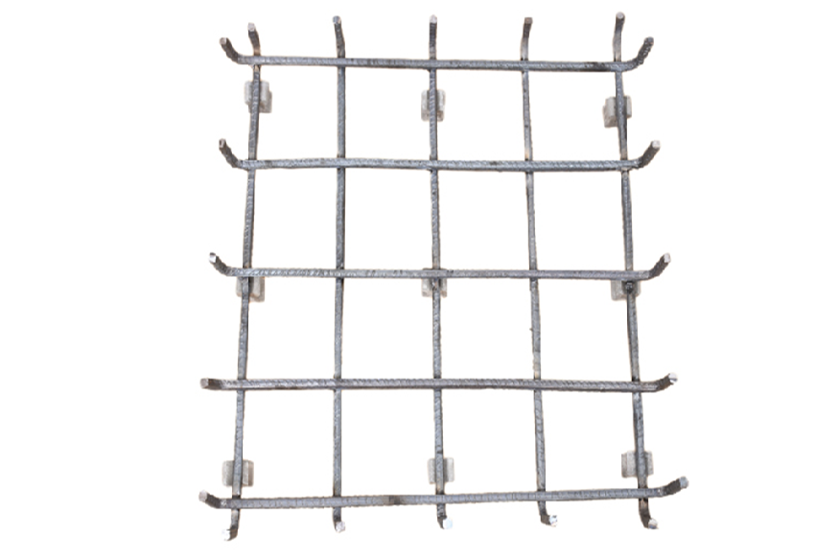
FOOTING JAAL
(WELDED)
“R - Reach for Good Product ”
10

Slide 25
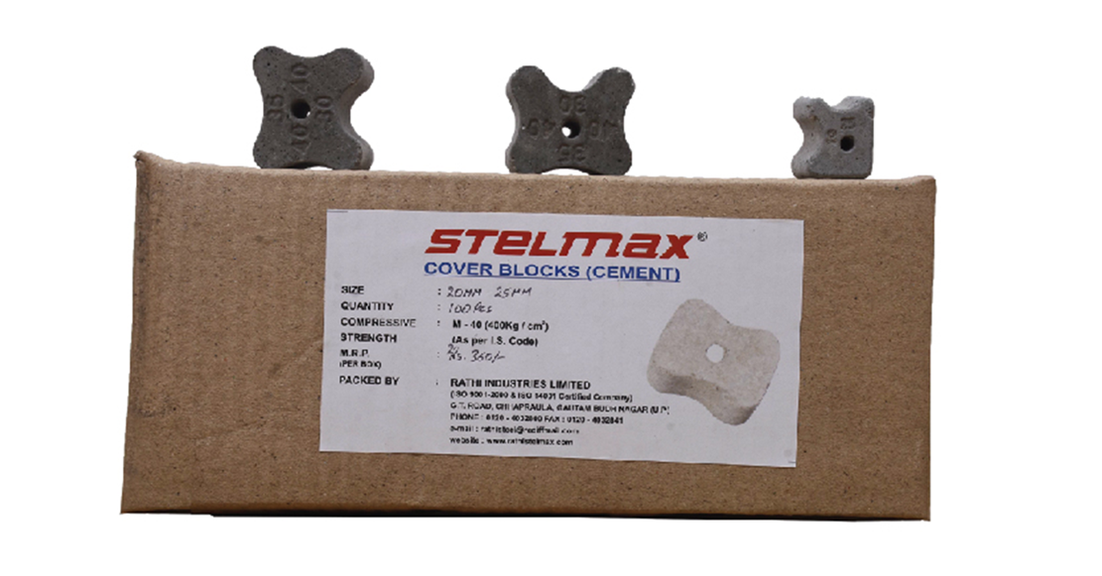
COVER BLOCKS
(STRENGTH M40)
“R - Reach for Good Product ”

Slide 26
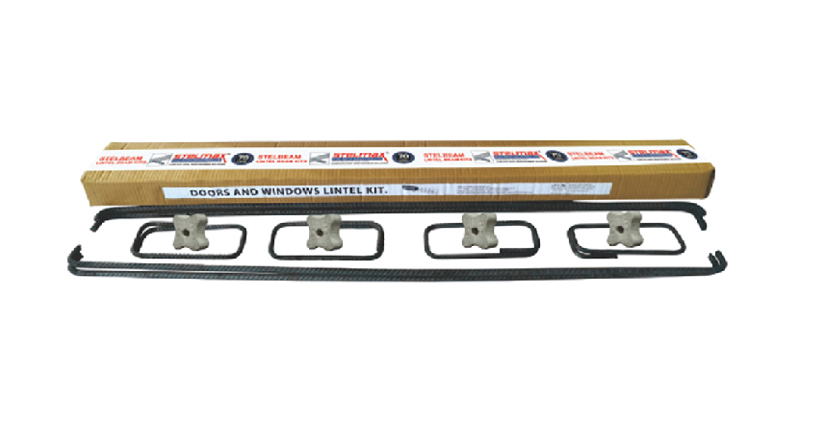
LINTEL BEAM KIT
(READY TO USE)
“R - Reach for Good Product ”

Slide 27
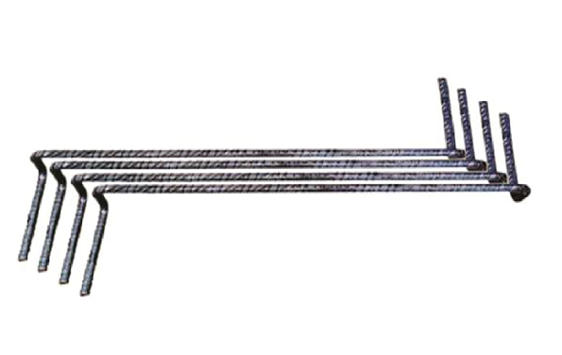
STEEL SPACER
( READY TO USE)
“R - Reach for Good Product ”

Slide 28
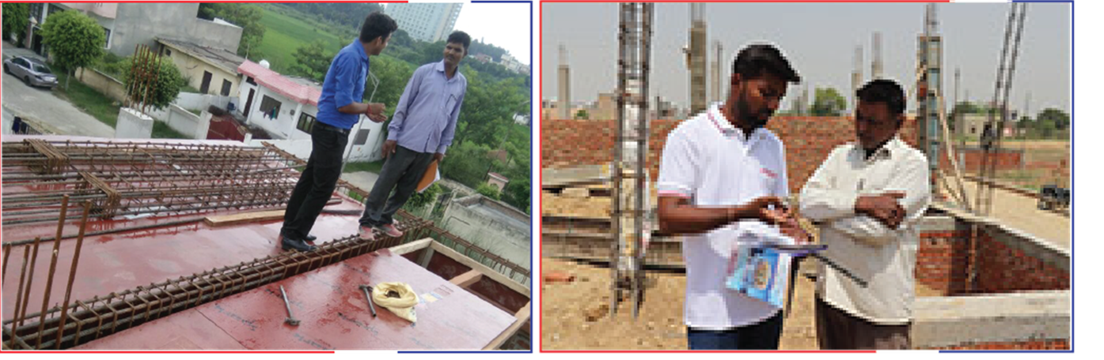
E - ENGAGE FOR TECHNICAL SUPPORT
“STELMAX provides technical visit at construction sites”.

Slide 29
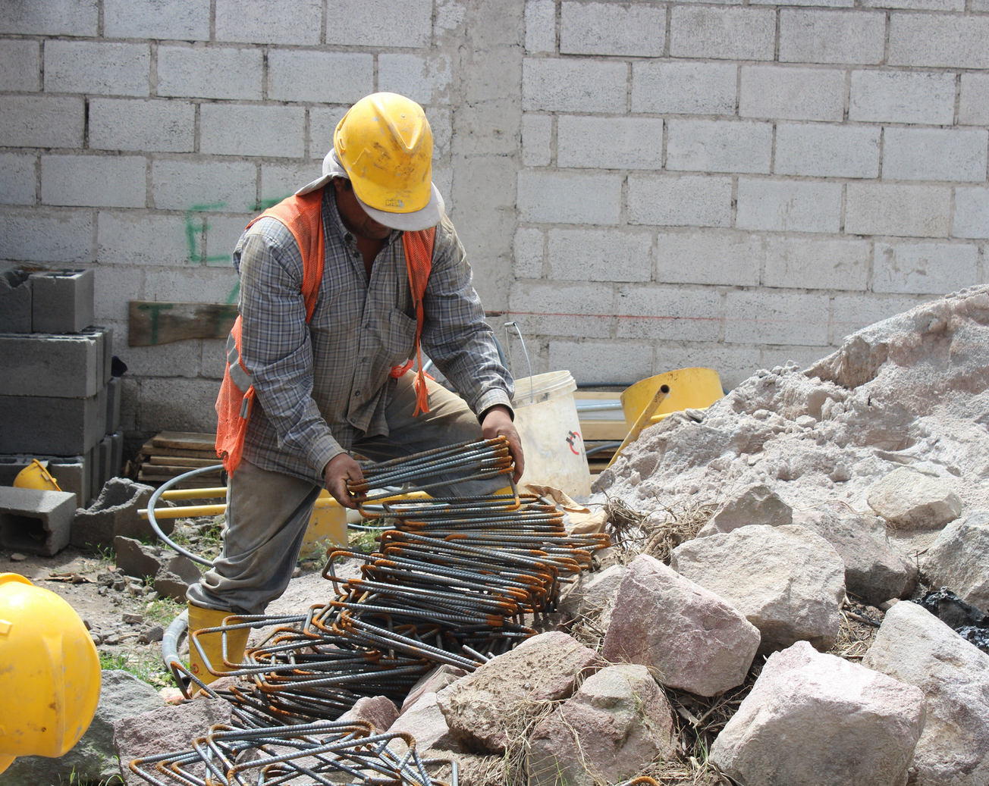
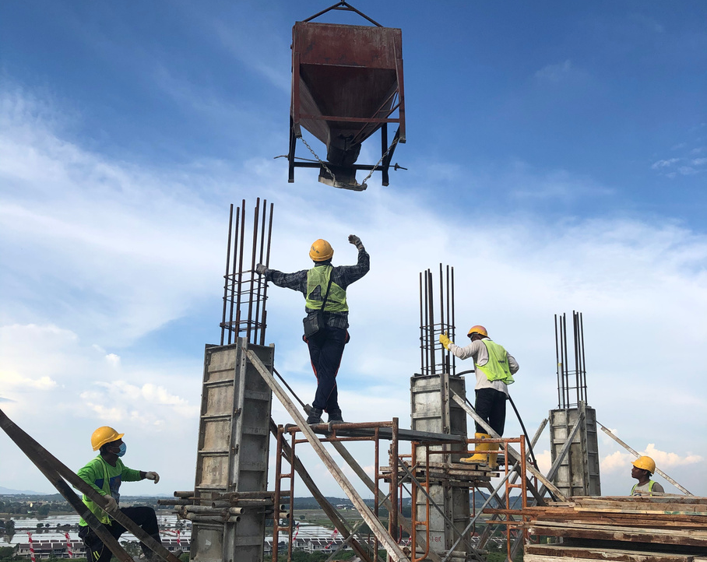

Helping people build strong houses with
STELMAX CARE.
OUR MOTTO

Slide 30

STELMAX CARE अपनाइए
मजबूत घर बनाइए

